Slide 1

NATO Core Data Framework Architecture
17 Oct 2019 17:44:42

Slide 2
Purpose
NATO Core Data Framework Architecture
2
/ 101

Slide 3
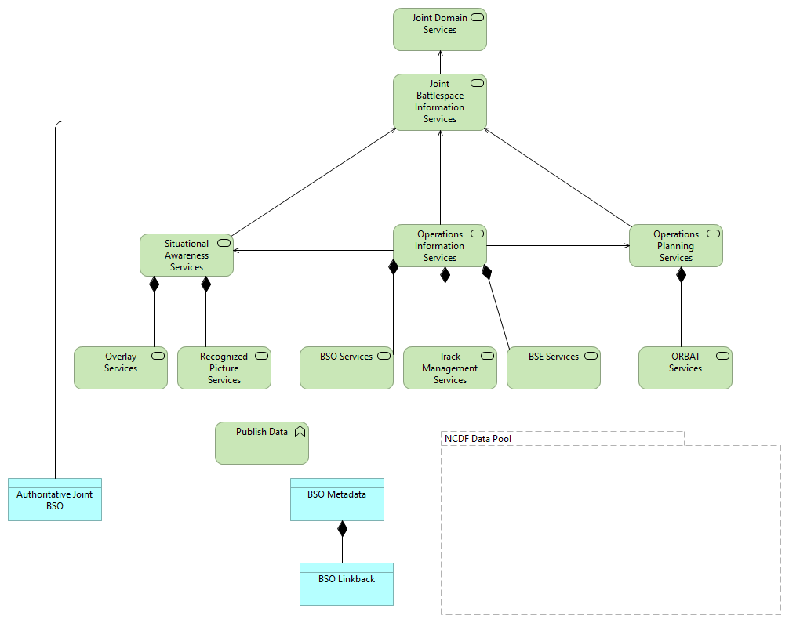
Views
C3T Joint Battlespace Information Services
No viewpoint
Elements
Element
Type
Authoritative Joint BSO
Data Object
BSE Services
Technology Service
BSO Linkback
Data Object
BSO Metadata
Data Object
BSO Services
Technology Service
Joint Battlespace Information Services
Technology Service
Joint Domain Services
Technology Service
NCDF Data Pool
Grouping
Operations Information Services
Technology Service
Operations Planning Services
Technology Service
ORBAT Services
Technology Service
Overlay Services
Technology Service
NATO Core Data Framework Architecture
3
/ 101

Slide 4
Element
Type
Publish Data
Technology Function
Recognized Picture Services
Technology Service
Situational Awareness Services
Technology Service
Track Management Services
Technology Service
NATO Core Data Framework Architecture
4
/ 101

Slide 5
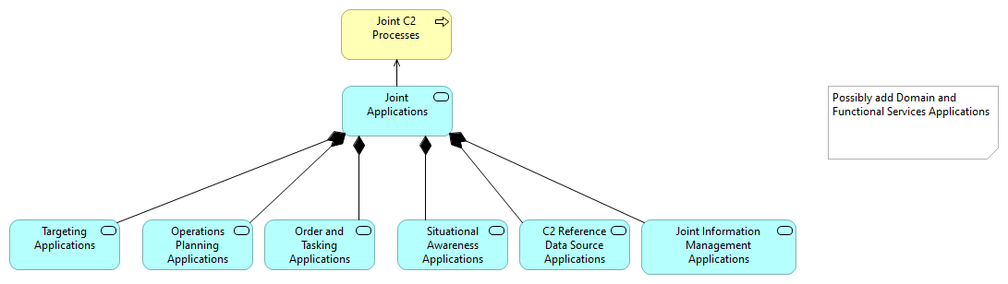
C3T Joint C2 Applications
No viewpoint
Elements
Element
Type
C2 Reference Data Source Applications
Application Service
Joint Applications
Application Service
Joint C2 Processes
Business Process
Joint Information Management Applications
Application Service
Operations Planning Applications
Application Service
Order and Tasking Applications
Application Service
Situational Awareness Applications
Application Service
Targeting Applications
Application Service
NATO Core Data Framework Architecture
5
/ 101

Slide 6
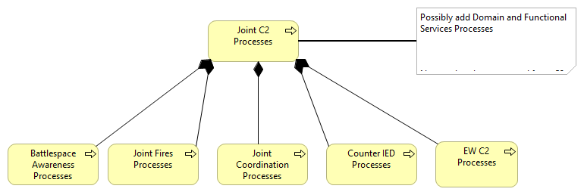
C3T Joint C2 Processes
No viewpoint
Documentation
Derived from C3 Taxonomy
Elements
Element
Type
Battlespace Awareness Processes
Business Process
Counter IED Processes
Business Process
EW C2 Processes
Business Process
Joint C2 Processes
Business Process
Joint Coordination Processes
Business Process
Joint Fires Processes
Business Process
NATO Core Data Framework Architecture
6
/ 101

Slide 7
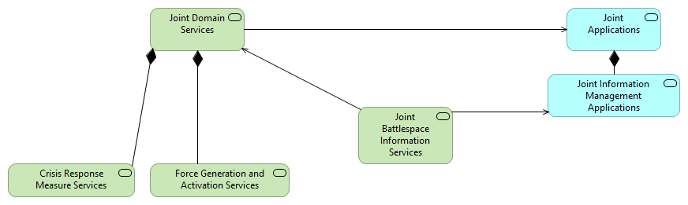
C3T Joint Domain Services
No viewpoint
Elements
Element
Type
Crisis Response Measure Services
Technology Service
Force Generation and Activation Services
Technology Service
Joint Applications
Application Service
Joint Battlespace Information Services
Technology Service
Joint Domain Services
Technology Service
Joint Information Management Applications
Application Service
NATO Core Data Framework Architecture
7
/ 101

Slide 8
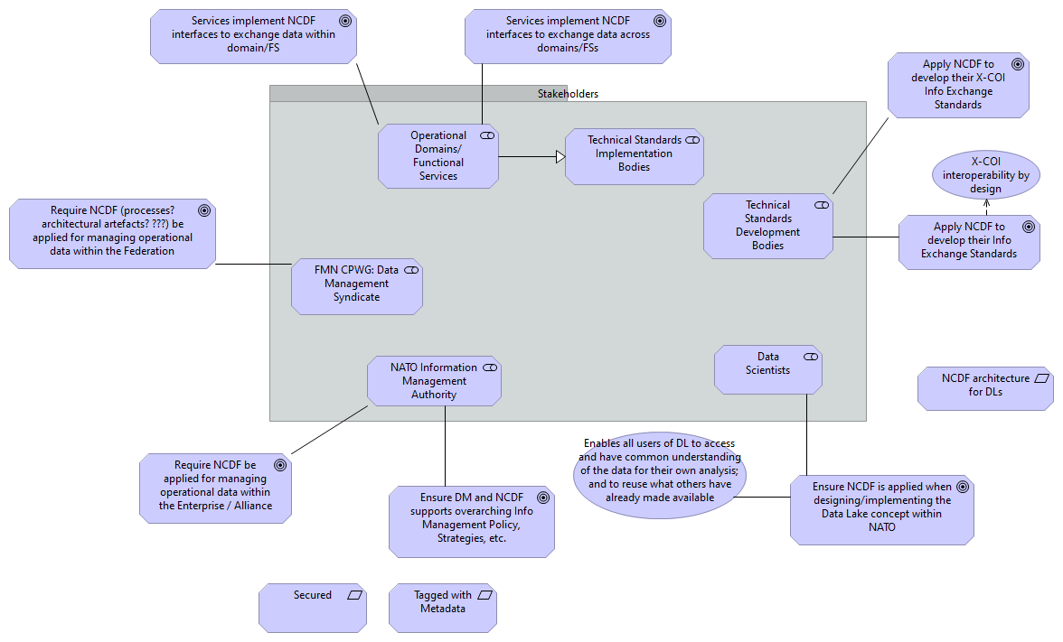
DM CaT Business Strategy C2
No viewpoint
Documentation
NIMROD: NATO Information Management, Registration, and Operational Data Platform
Elements
Element
Type
Apply NCDF to develop their Info Exchange Standards
Goal
Apply NCDF to develop their X-COI Info Exchange Standards
Goal
Data Scientists
Stakeholder
Enables all users of DL to access and have common understanding of the data for their own analysis; and to reuse what others have already made available
Value
Ensure DM and NCDF supports overarching Info Management Policy, Strategies, etc.
Goal
Ensure NCDF is applied when designing/implementing the Data Lake concept within NATO
Goal
FMN CPWG: Data Management Syndicate
Stakeholder
NATO Information Management Authority
Stakeholder
NCDF architecture for DLs
Requirement
Operational Domains/Functional Services
Stakeholder
NATO Core Data Framework Architecture
8
/ 101

Slide 9
Element
Type
Require NCDF (processes? architectural artefacts? ???) be applied for managing operational data within the Federation
Goal
Require NCDF be applied for managing operational data within the Enterprise / Alliance
Goal
Secured
Requirement
Services implement NCDF interfaces to exchange data across domains/FSs
Goal
Services implement NCDF interfaces to exchange data within domain/FS
Goal
Tagged with Metadata
Requirement
Technical Standards Development Bodies
Stakeholder
Technical Standards Implementation Bodies
Stakeholder
X-COI interoperability by design
Value
NATO Core Data Framework Architecture
9
/ 101

Slide 10
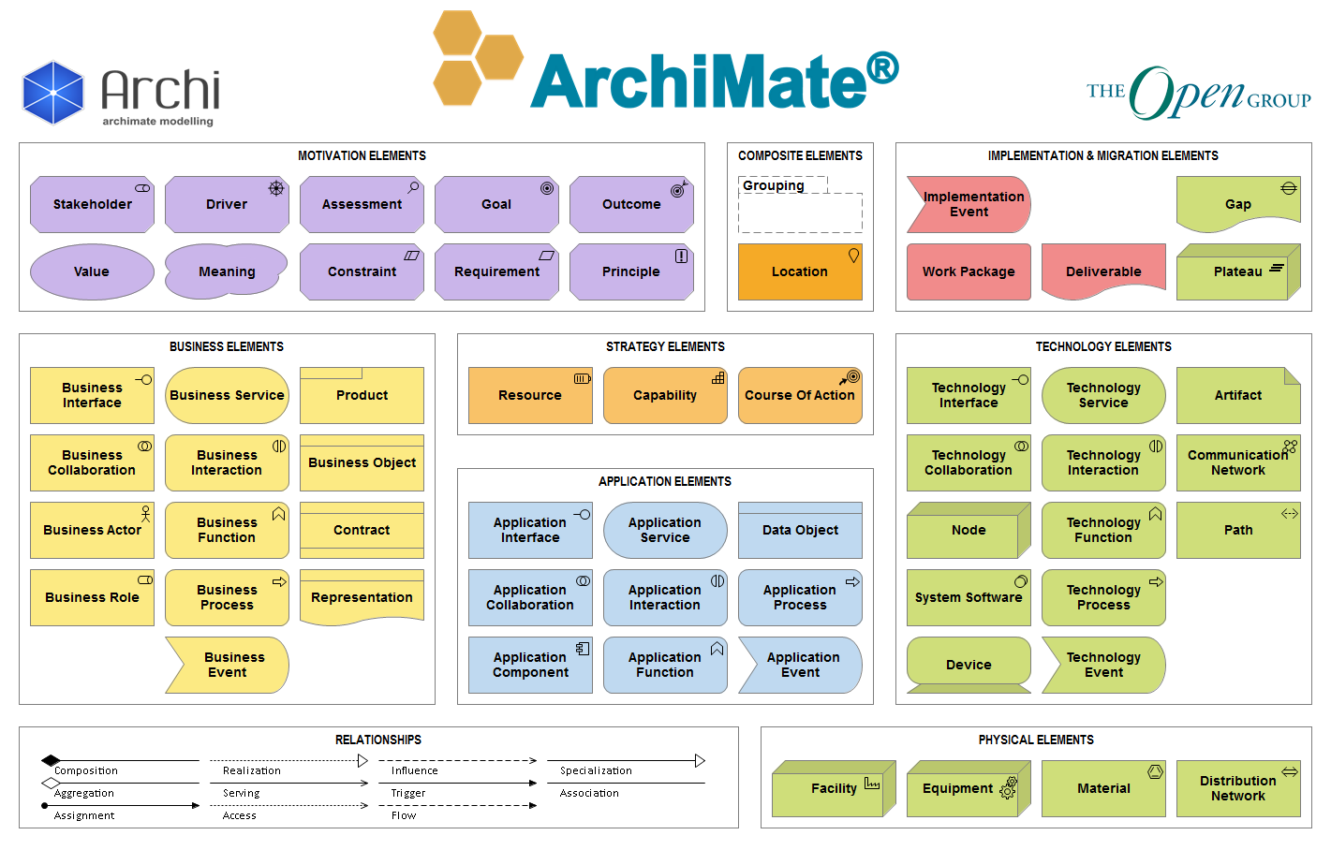
NCDF A2.1 ArchiMate 3.0 Notation Overview
Documentation
Overview of Archimate Elementes and Colors
NATO Core Data Framework Architecture
10
/ 101

Slide 11
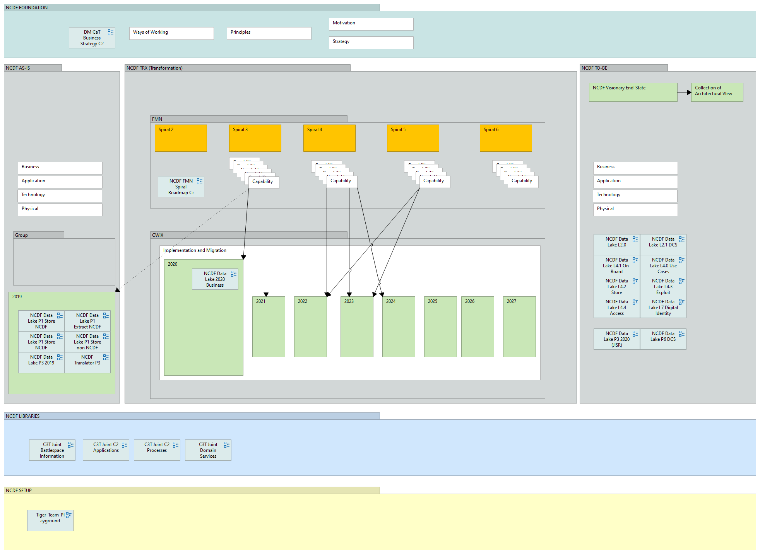
NCDF A2.2 Architecture Product Structure
Documentation
This View describes the logic behind the architectual work in the DM CaT. Step 1: Describe the visionary end-state of NCDF (WHY; WHAT): Dirvers, Goals, Capabilities Step 2: Describe what what we actually have Step 3: Define what NCDF Aspects will become mandatory in what FMN Spiral Spec Step 4: Define the Use Cases, Functions to be realized & tested in CWIX
NATO Core Data Framework Architecture
11
/ 101

Slide 12
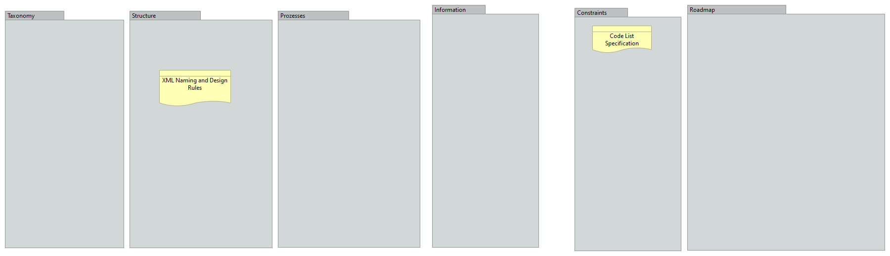
NCDF Architecture Product A2.2
No viewpoint
Documentation
Initially created by Severin Waber.
Elements
Element
Type
Code List Specification
Representation
XML Naming and Design Rules
Representation
NATO Core Data Framework Architecture
12
/ 101

Slide 13
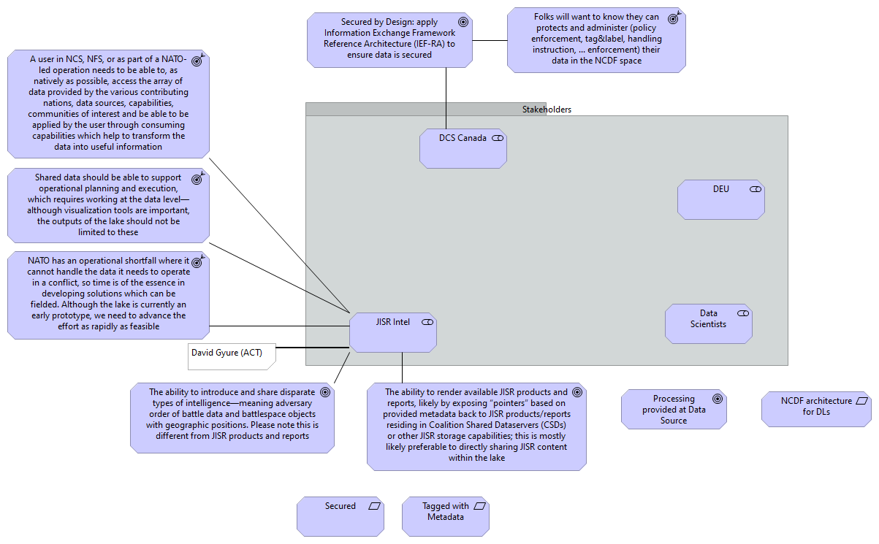
NCDF Data Lake 2020 Business Strategy Inputs C2
No viewpoint
Documentation
NIMROD: NATO Information Management, Registration, and Operational Data Platform
Elements
Element
Type
A user in NCS, NFS, or as part of a NATO-led operation needs to be able to, as natively as possible, access the array of data provided by the various contributing nations, data sources, capabilities, communities of interest and be able to be applied by the user through consuming capabilities which help to transform the data into useful information
Outcome
Data Scientists
Stakeholder
DCS Canada
Stakeholder
DEU
Stakeholder
Folks will want to know they can protects and administer (policy enforcement, tag&label, handling instruction, ... enforcement) their data in the NCDF space
Outcome
JISR Intel
Stakeholder
NATO has an operational shortfall where it cannot handle the data it needs to operate in a conflict, so time is of the essence in developing solutions
Outcome
NATO Core Data Framework Architecture
13
/ 101

Slide 14
Element
Type
which can be fielded. Although the lake is currently an early prototype, we need to advance the effort as rapidly as feasible
NCDF architecture for DLs
Requirement
Processing provided at Data Source
Goal
Secured
Requirement
Secured by Design: apply Information Exchange Framework Reference Architecture (IEF-RA) to ensure data is secured
Goal
Shared data should be able to support operational planning and execution, which requires working at the data level—although visualization tools are important, the outputs of the lake should not be limited to these
Outcome
Tagged with Metadata
Requirement
The ability to introduce and share disparate types of intelligence—meaning adversary order of battle data and battlespace objects with geographic positions. Please note this is different from JISR products and reports
Goal
The ability to render available JISR products and reports, likely by exposing “pointers” based on provided metadata back to JISR products/reports residing in Coalition Shared Dataservers (CSDs) or other JISR storage capabilities; this is mostly likely preferable to directly sharing JISR content within the lake
Goal
NATO Core Data Framework Architecture
14
/ 101

Slide 15
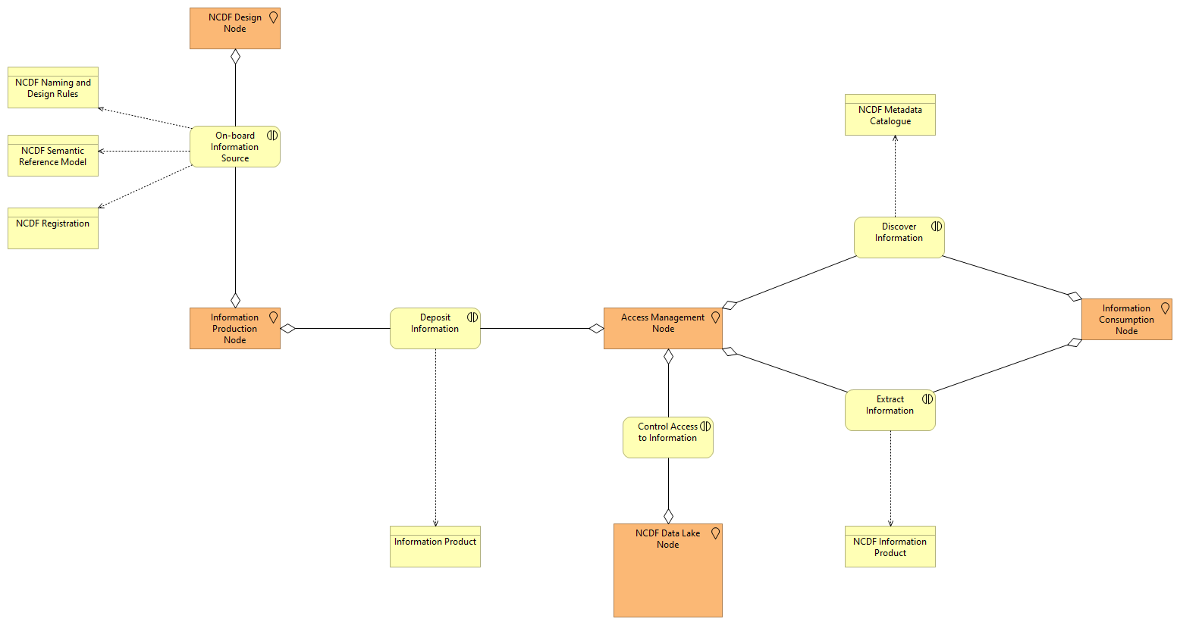
NCDF Data Lake L2.0
No viewpoint
Elements
Element
Type
Access Management Node
Location
Control Access to Information
Business Interaction
Deposit Information
Business Interaction
Discover Information
Business Interaction
Extract Information
Business Interaction
Information Consumption Node
Location
Information Product
Business Object
Information Production Node
Location
NCDF Data Lake Node
Location
NCDF Design Node
Location
NCDF Information Product
Business Object
NCDF Metadata Catalogue
Business Object
NCDF Naming and Design Rules
Business Object
NCDF Registration
Business Object
NCDF Semantic Reference Model
Business Object
On-board Information Source
Business Interaction
NATO Core Data Framework Architecture
15
/ 101

Slide 16
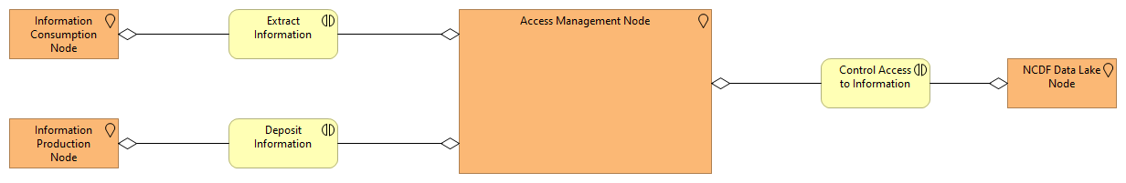
NCDF Data Lake L2.1 DCS
No viewpoint
Elements
Element
Type
Access Management Node
Location
Control Access to Information
Business Interaction
Deposit Information
Business Interaction
Extract Information
Business Interaction
Information Consumption Node
Location
Information Production Node
Location
NCDF Data Lake Node
Location
NATO Core Data Framework Architecture
16
/ 101

Slide 17
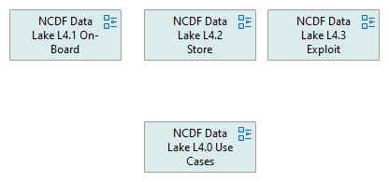
NCDF Data Lake L4 Overall
No viewpoint
NATO Core Data Framework Architecture
17
/ 101

Slide 18
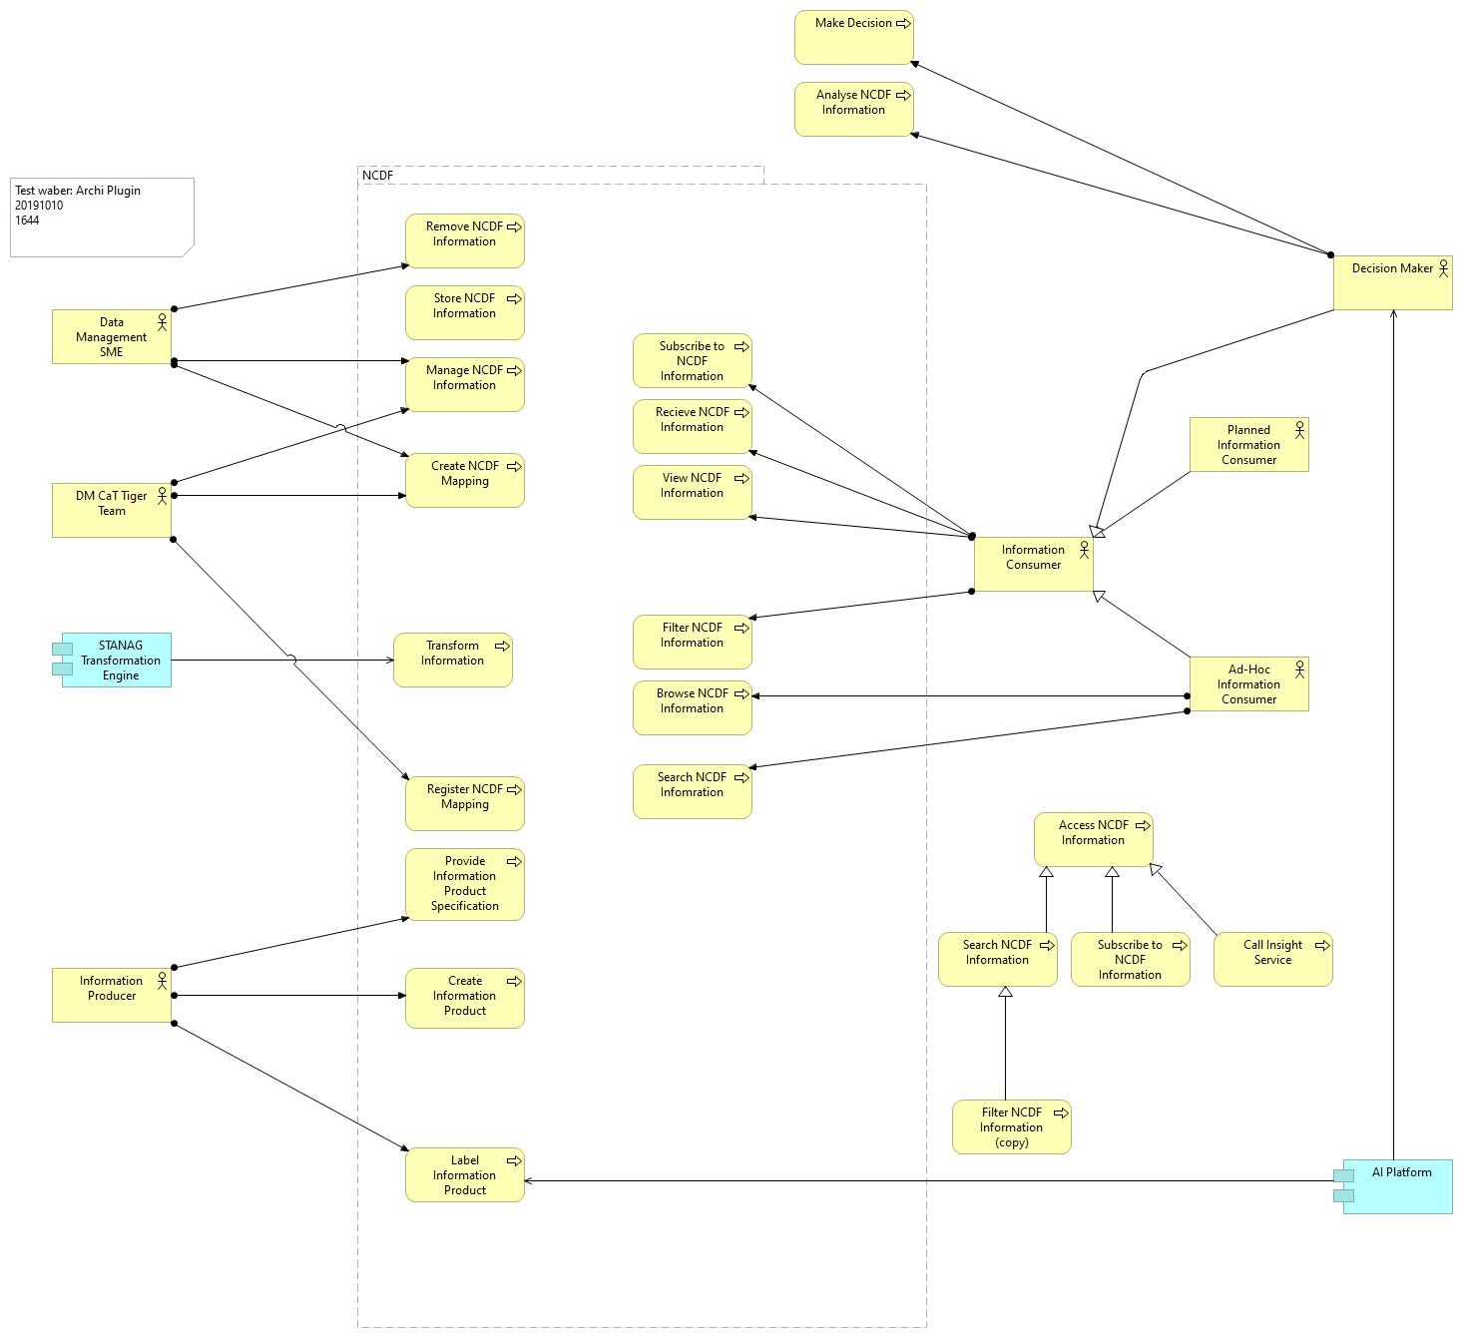
NCDF Data Lake L4.0 Use Cases
No viewpoint
Elements
Element
Type
Access NCDF Information
Business Process
Ad-Hoc Information Consumer
Business Actor
AI Platform
Application Component
Analyse NCDF Information
Business Process
Browse NCDF Information
Business Process
Call Insight Service
Business Process
Create Information Product
Business Process
Create NCDF Mapping
Business Process
Data Management SME
Business Actor
Decision Maker
Business Actor
NATO Core Data Framework Architecture
18
/ 101

Slide 19
Element
Type
DM CaT Tiger Team
Business Actor
Filter NCDF Information
Business Process
Filter NCDF Information (copy)
Business Process
Information Consumer
Business Actor
Information Producer
Business Actor
Label Information Product
Business Process
Make Decision
Business Process
Manage NCDF Information
Business Process
NCDF
Grouping
Planned Information Consumer
Business Actor
Provide Information Product Specification
Business Process
Recieve NCDF Information
Business Process
Register NCDF Mapping
Business Process
Remove NCDF Information
Business Process
Search NCDF Infomration
Business Process
Search NCDF Information
Business Process
STANAG Transformation Engine
Application Component
Store NCDF Information
Business Process
Subscribe to NCDF Information
Business Process
Subscribe to NCDF Information
Business Process
Transform Information
Business Process
View NCDF Information
Business Process
NATO Core Data Framework Architecture
19
/ 101

Slide 20
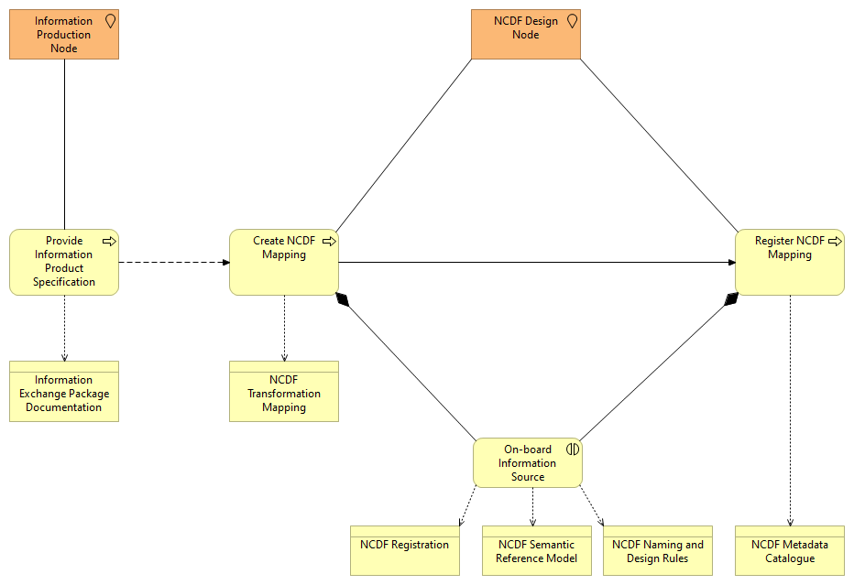
NCDF Data Lake L4.1 On-Board
No viewpoint
Elements
Element
Type
Create NCDF Mapping
Business Process
Information Exchange Package Documentation
Business Object
Information Production Node
Location
NCDF Design Node
Location
NCDF Metadata Catalogue
Business Object
NCDF Naming and Design Rules
Business Object
NCDF Registration
Business Object
NCDF Semantic Reference Model
Business Object
NCDF Transformation Mapping
Business Object
On-board Information Source
Business Interaction
Provide Information Product Specification
Business Process
Register NCDF Mapping
Business Process
NATO Core Data Framework Architecture
20
/ 101

Slide 21
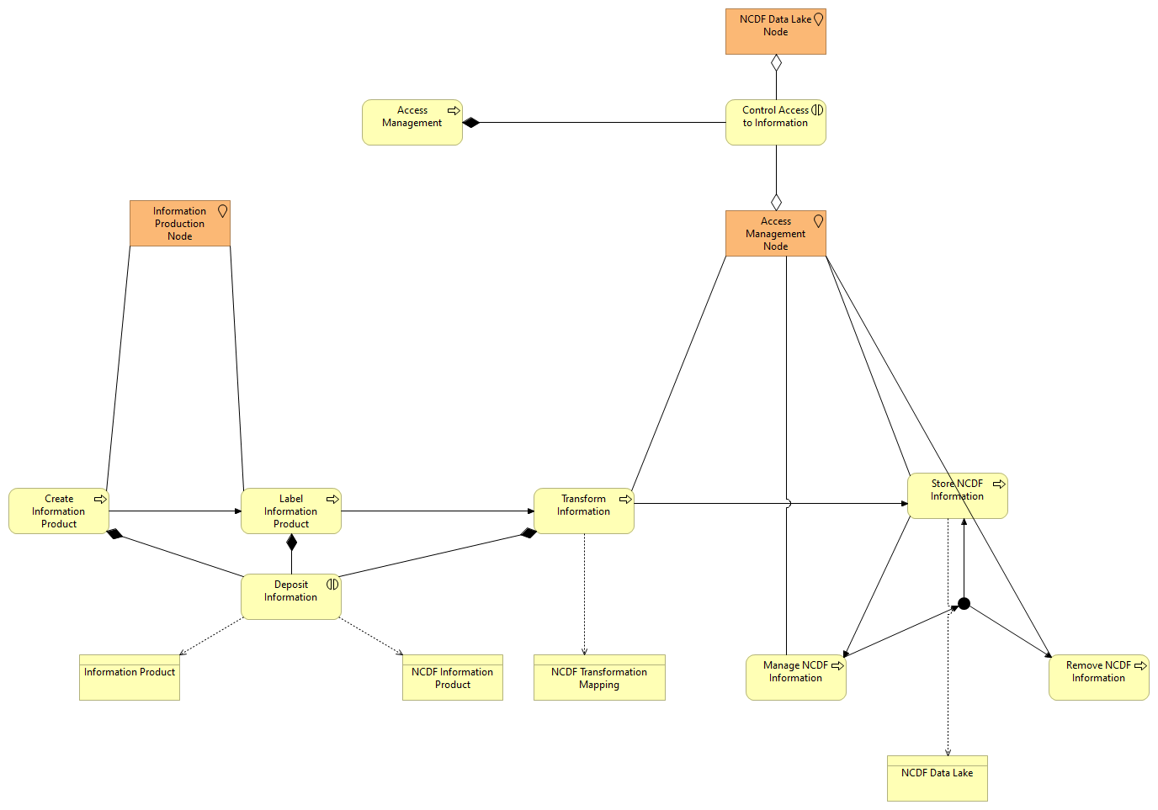
NCDF Data Lake L4.2 Store
No viewpoint
Elements
Element
Type
Access Management
Business Process
Access Management Node
Location
Control Access to Information
Business Interaction
Create Information Product
Business Process
Deposit Information
Business Interaction
Information Product
Business Object
Information Production Node
Location
Junction
Junction
Label Information Product
Business Process
Manage NCDF Information
Business Process
NCDF Data Lake
Business Object
NCDF Data Lake Node
Location
NCDF Information Product
Business Object
NCDF Transformation Mapping
Business Object
Remove NCDF Information
Business Process
Store NCDF Information
Business Process
Transform Information
Business Process
NATO Core Data Framework Architecture
21
/ 101

Slide 22
NATO Core Data Framework Architecture
22
/ 101

Slide 23
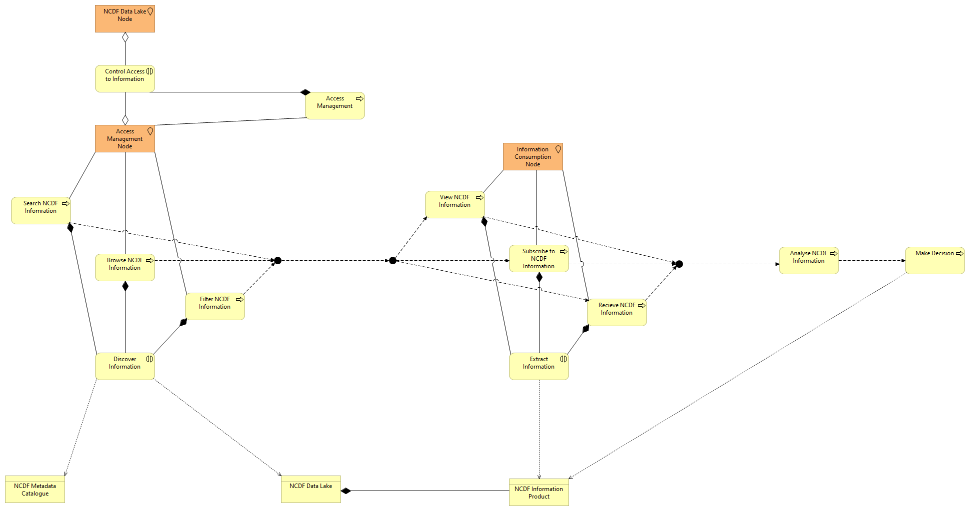
NCDF Data Lake L4.3 Exploit
No viewpoint
Elements
Element
Type
Access Management
Business Process
Access Management Node
Location
Analyse NCDF Information
Business Process
Browse NCDF Information
Business Process
Control Access to Information
Business Interaction
Discover Information
Business Interaction
Extract Information
Business Interaction
Filter NCDF Information
Business Process
Information Consumption Node
Location
Junction
Junction
Junction
Junction
Junction
Junction
Make Decision
Business Process
NCDF Data Lake
Business Object
NCDF Data Lake Node
Location
NCDF Information Product
Business Object
NCDF Metadata Catalogue
Business Object
Recieve NCDF Information
Business Process
Search NCDF Infomration
Business Process
Subscribe to NCDF Information
Business Process
View NCDF Information
Business Process
NATO Core Data Framework Architecture
23
/ 101

Slide 24
NATO Core Data Framework Architecture
24
/ 101

Slide 25
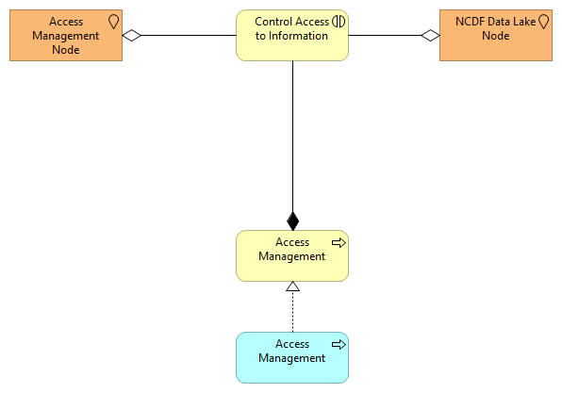
NCDF Data Lake L4.4 Access Control
No viewpoint
Elements
Element
Type
Access Management
Business Process
Access Management
Application Process
Access Management Node
Location
Control Access to Information
Business Interaction
NCDF Data Lake Node
Location
NATO Core Data Framework Architecture
25
/ 101

Slide 26
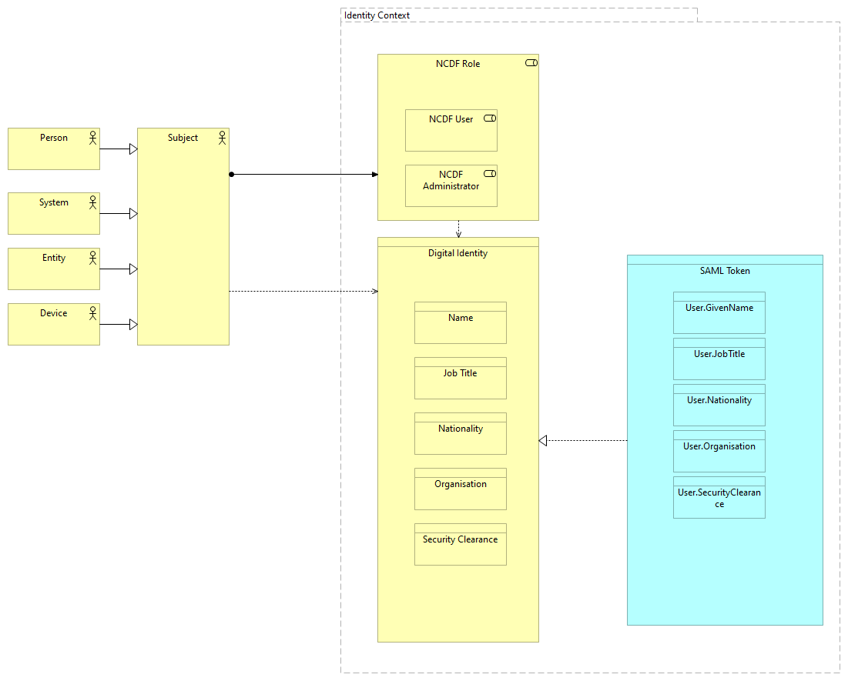
NCDF Data Lake L7 Digital Identity
No viewpoint
Elements
Element
Type
Device
Business Actor
Digital Identity
Business Object
Entity
Business Actor
Identity Context
Grouping
Job Title
Business Object
Name
Business Object
Nationality
Business Object
NCDF Administrator
Business Role
NCDF Role
Business Role
NCDF User
Business Role
Organisation
Business Object
Person
Business Actor
SAML Token
Data Object
Security Clearance
Business Object
NATO Core Data Framework Architecture
26
/ 101

Slide 27
Element
Type
Subject
Business Actor
System
Business Actor
User.GivenName
Data Object
User.JobTitle
Data Object
User.Nationality
Data Object
User.Organisation
Data Object
User.SecurityClearance
Data Object
NATO Core Data Framework Architecture
27
/ 101

Slide 28
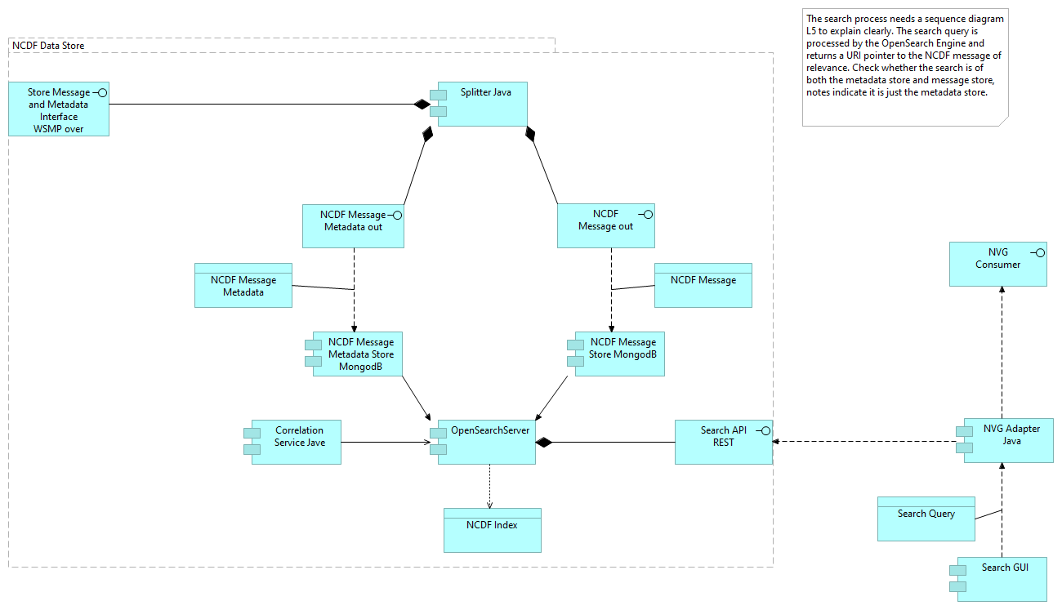
NCDF Data Lake P1 Extract NCDF
No viewpoint
Elements
Element
Type
Correlation Service Jave
Application Component
NCDF Data Store
Grouping
NCDF Index
Data Object
NCDF Message
Data Object
NCDF Message Metadata
Data Object
NCDF Message Metadata out
Application Interface
NCDF Message Metadata Store MongodB
Application Component
NCDF Message out
Application Interface
NCDF Message Store MongodB
Application Component
NVG Adapter Java
Application Component
NVG Consumer
Application Interface
OpenSearchServer
Application Component
Search API REST
Application Interface
Search GUI
Application Component
Search Query
Data Object
Splitter Java
Application Component
Store Message and Metadata Interface WSMP over REST
Application Interface
NATO Core Data Framework Architecture
28
/ 101

Slide 29
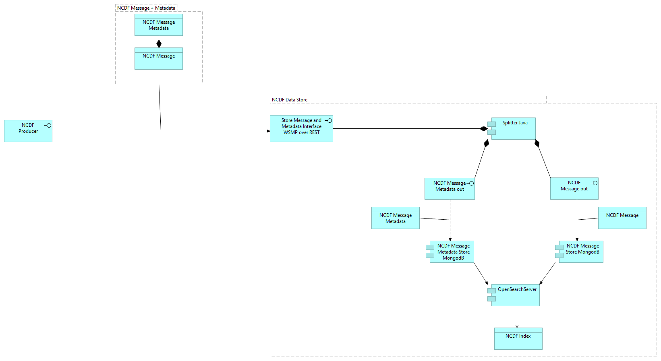
NCDF Data Lake P1 Store NCDF Producer
No viewpoint
Elements
Element
Type
NCDF Data Store
Grouping
NCDF Index
Data Object
NCDF Message
Data Object
NCDF Message + Metadata
Grouping
NCDF Message Metadata
Data Object
NCDF Message Metadata out
Application Interface
NCDF Message Metadata Store MongodB
Application Component
NCDF Message out
Application Interface
NCDF Message Store MongodB
Application Component
NCDF Producer
Application Interface
OpenSearchServer
Application Component
Splitter Java
Application Component
Store Message and Metadata Interface WSMP over REST
Application Interface
NATO Core Data Framework Architecture
29
/ 101

Slide 30
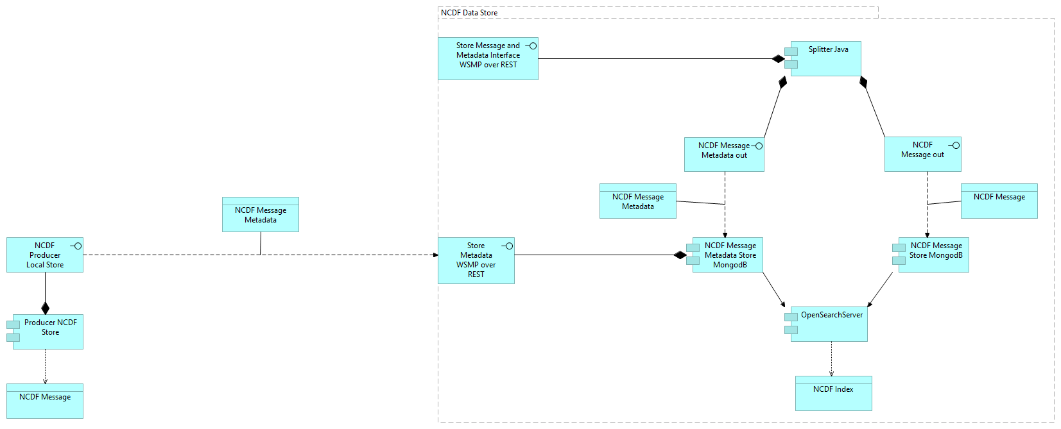
NCDF Data Lake P1 Store NCDF Producer Local Store
No viewpoint
Elements
Element
Type
NCDF Data Store
Grouping
NCDF Index
Data Object
NCDF Message
Data Object
NCDF Message Metadata
Data Object
NCDF Message Metadata out
Application Interface
NCDF Message Metadata Store MongodB
Application Component
NCDF Message out
Application Interface
NCDF Message Store MongodB
Application Component
NCDF Producer Local Store
Application Interface
OpenSearchServer
Application Component
Producer NCDF Store
Application Component
Splitter Java
Application Component
Store Message and Metadata Interface WSMP over REST
Application Interface
Store Metadata WSMP over REST
Application Interface
NATO Core Data Framework Architecture
30
/ 101

Slide 31
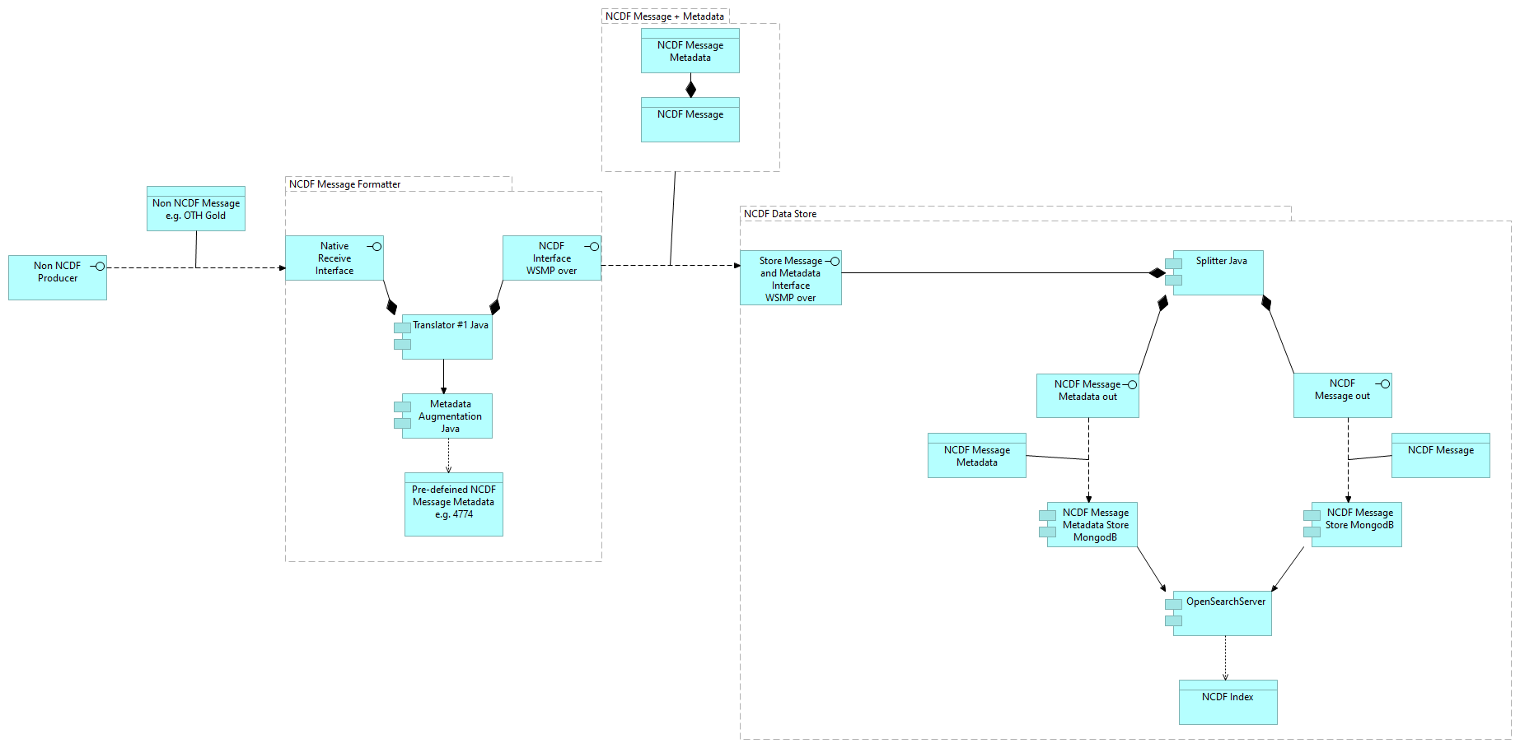
NCDF Data Lake P1 Store non NCDF Producer
No viewpoint
Elements
Element
Type
Metadata Augmentation Java
Application Component
Native Receive Interface
Application Interface
NCDF Data Store
Grouping
NCDF Index
Data Object
NCDF Interface WSMP over REST
Application Interface
NCDF Message
Data Object
NCDF Message + Metadata
Grouping
NCDF Message Formatter
Grouping
NCDF Message Metadata
Data Object
NCDF Message Metadata out
Application Interface
NCDF Message Metadata Store MongodB
Application Component
NCDF Message out
Application Interface
NCDF Message Store MongodB
Application Component
Non NCDF Message e.g. OTH Gold
Data Object
Non NCDF Producer
Application Interface
OpenSearchServer
Application Component
Pre-defeined NCDF Message Metadata e.g. 4774
Data Object
Splitter Java
Application Component
Store Message and Metadata Interface WSMP over REST
Application Interface
Translator #1 Java
Application Component
NATO Core Data Framework Architecture
31
/ 101

Slide 32
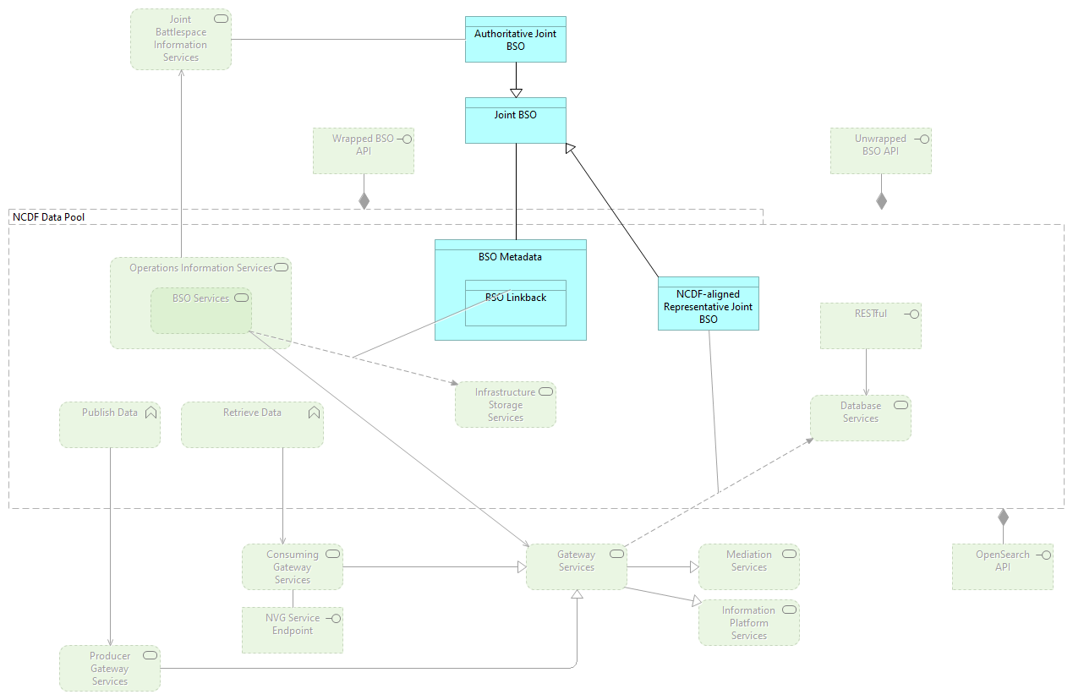
NCDF Data Lake P3 2019
Application Cooperation viewpoint
Elements
Element
Type
Authoritative Joint BSO
Data Object
BSO Linkback
Data Object
BSO Metadata
Data Object
BSO Services
Technology Service
Consuming Gateway Services
Technology Service
Database Services
Technology Service
Gateway Services
Technology Service
Information Platform Services
Technology Service
Infrastructure Storage Services
Technology Service
Joint Battlespace Information Services
Technology Service
Joint BSO
Data Object
Mediation Services
Technology Service
NCDF Data Pool
Grouping
NCDF-aligned Representative Joint BSO
Data Object
NVG Service Endpoint
Technology Interface
OpenSearch API
Technology Interface
Operations Information Services
Technology Service
Producer Gateway Services
Technology Service
NATO Core Data Framework Architecture
32
/ 101

Slide 33
Element
Type
Publish Data
Technology Function
RESTful
Technology Interface
Retrieve Data
Technology Function
Unwrapped BSO API
Technology Interface
Wrapped BSO API
Technology Interface
NATO Core Data Framework Architecture
33
/ 101

Slide 34
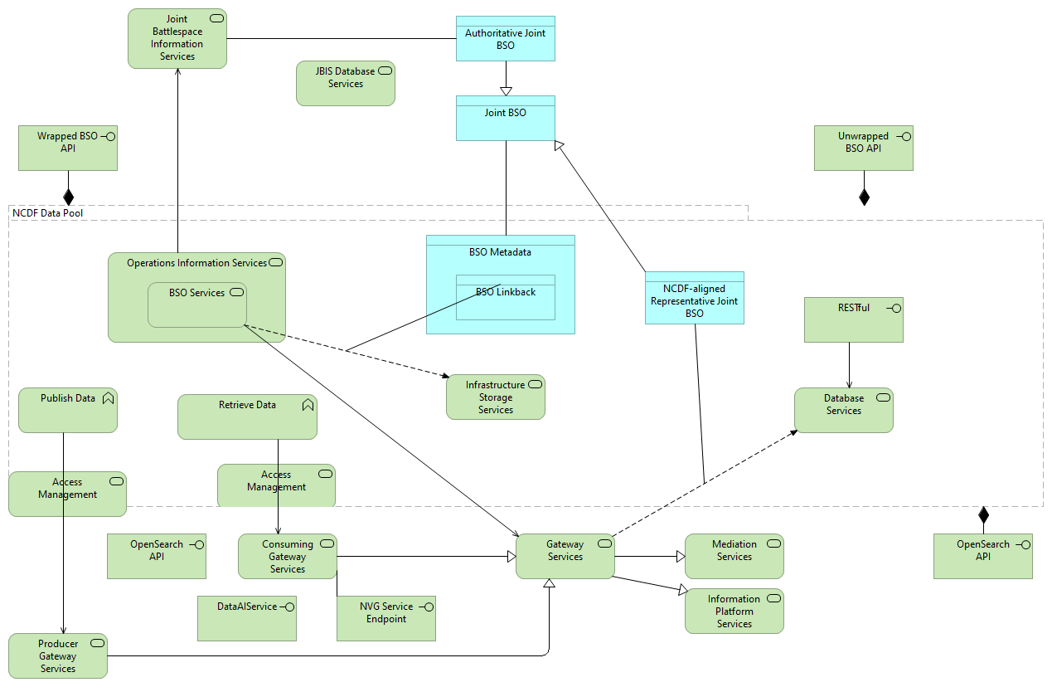
NCDF Data Lake P3 2020 (JISR)
No viewpoint
Elements
Element
Type
Access Management
Technology Service
Access Management
Technology Service
Authoritative Joint BSO
Data Object
BSO Linkback
Data Object
BSO Metadata
Data Object
BSO Services
Technology Service
Consuming Gateway Services
Technology Service
DataAIService
Technology Interface
Database Services
Technology Service
Gateway Services
Technology Service
Information Platform Services
Technology Service
Infrastructure Storage Services
Technology Service
JBIS Database Services
Technology Service
Joint Battlespace Information Services
Technology Service
Joint BSO
Data Object
Mediation Services
Technology Service
NCDF Data Pool
Grouping
NCDF-aligned Representative Joint BSO
Data Object
NATO Core Data Framework Architecture
34
/ 101

Slide 35
Element
Type
NVG Service Endpoint
Technology Interface
OpenSearch API
Technology Interface
OpenSearch API
Technology Interface
Operations Information Services
Technology Service
Producer Gateway Services
Technology Service
Publish Data
Technology Function
RESTful
Technology Interface
Retrieve Data
Technology Function
Unwrapped BSO API
Technology Interface
Wrapped BSO API
Technology Interface
NATO Core Data Framework Architecture
35
/ 101

Slide 36
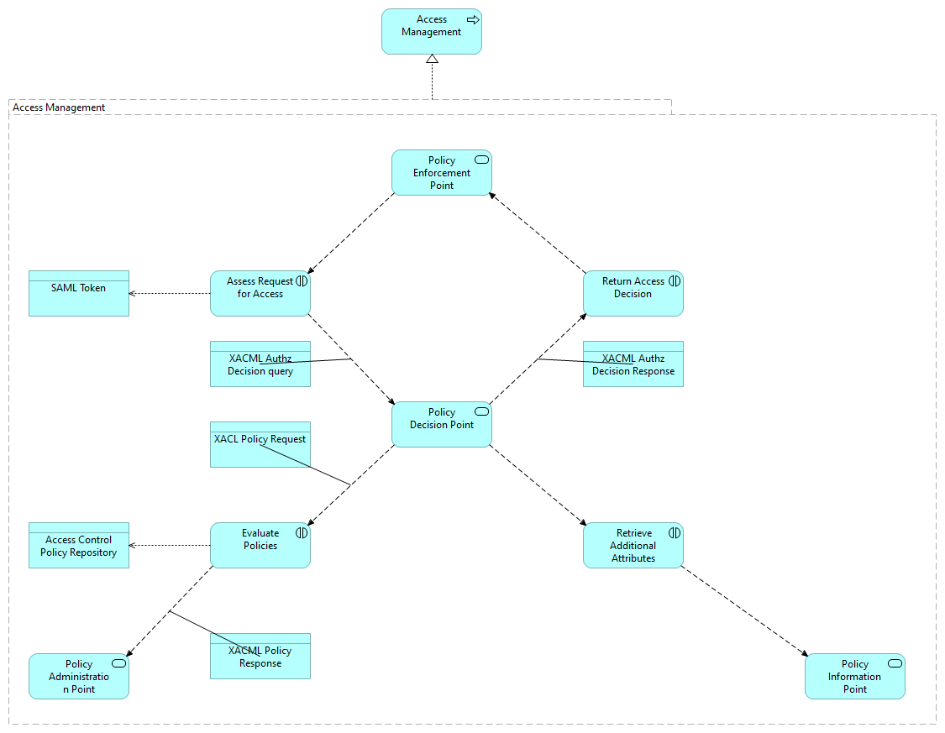
NCDF Data Lake P6 DCS
No viewpoint
Elements
Element
Type
Access Control Policy Repository
Data Object
Access Management
Application Process
Access Management
Grouping
Assess Request for Access
Application Interaction
Evaluate Policies
Application Interaction
Policy Administration Point
Application Service
Policy Decision Point
Application Service
Policy Enforcement Point
Application Service
Policy Information Point
Application Service
Retrieve Additional Attributes
Application Interaction
Return Access Decision
Application Interaction
SAML Token
Data Object
XACL Policy Request
Data Object
XACML Authz Decision query
Data Object
XACML Authz Decision Response
Data Object
NATO Core Data Framework Architecture
36
/ 101

Slide 37
Element
Type
XACML Policy Response
Data Object
NATO Core Data Framework Architecture
37
/ 101

Slide 38
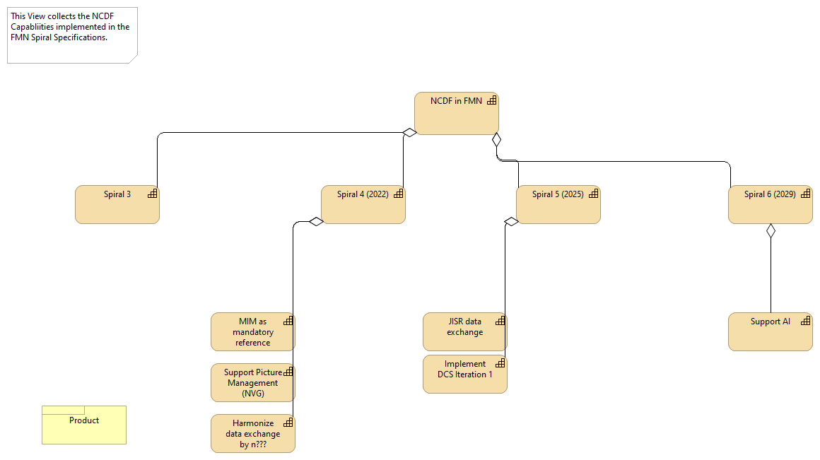
NCDF FMN Spiral Roadmap Cr
No viewpoint
Documentation
Initially created by Severin Waber. The DM CaT works in the FMN Community as the FMN Data Management Syndicate. This view shows what capabilities is planned to realize in what Spiral.
Properties
Elements
Element
Type
Harmonize data exchange by n???
Capability
Implement DCS Iteration 1
Capability
JISR data exchange
Capability
MIM as mandatory reference
Capability
NCDF in FMN
Capability
Product
Product
Spiral 3
Capability
Spiral 4 (2022)
Capability
Spiral 5 (2025)
Capability
Spiral 6 (2029)
Capability
Support AI
Capability
Support Picture Management (NVG)
Capability
NATO Core Data Framework Architecture
38
/ 101

Slide 39
NATO Core Data Framework Architecture
39
/ 101

Slide 40
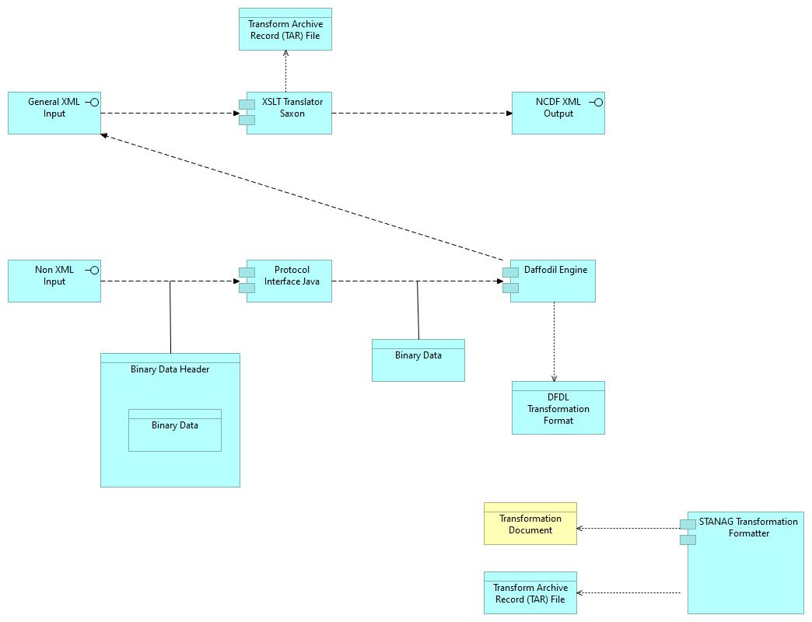
NCDF Translator P3
No viewpoint
Elements
Element
Type
Binary Data
Data Object
Binary Data Header
Data Object
Daffodil Engine
Application Component
DFDL Transformation Format
Data Object
General XML Input
Application Interface
NCDF XML Output
Application Interface
Non XML Input
Application Interface
Protocol Interface Java
Application Component
STANAG Transformation Formatter
Application Component
Transform Archive Record (TAR) File
Data Object
Transformation Document
Business Object
XSLT Translator Saxon
Application Component
NATO Core Data Framework Architecture
40
/ 101

Slide 41
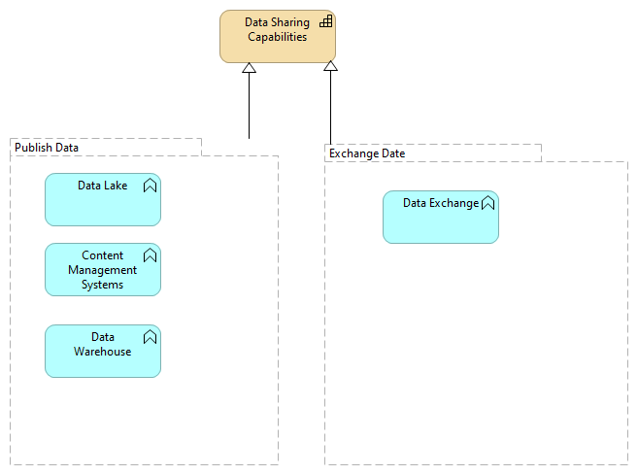
Tiger_Team_Playground
No viewpoint
Documentation
This View is a playground to test the different Archi Functions.
Elements
Element
Type
Content Management Systems
Application Function
Data Exchange
Application Function
Data Lake
Application Function
Data Sharing Capabilities
Capability
Data Warehouse
Application Function
Exchange Date
Grouping
Publish Data
Grouping
NATO Core Data Framework Architecture
41
/ 101

Slide 42
Strategy Layer
Data Sharing Capabilities
Type
Capability
Harmonize data exchange by n???
Type
Capability
Implement DCS Iteration 1
Type
Capability
DCS Maturity Level 1: Label all information
JISR data exchange
Type
Capability
MIM as mandatory reference
Type
Capability
NCDF in FMN
Type
Capability
Spiral 3
Type
Capability
Spiral 4 (2022)
Type
Capability
Spiral 5 (2025)
Type
Capability
Spiral 6 (2029)
Type
Capability
Support AI
Type
Capability
Support Picture Management (NVG)
Type
Capability
NATO Core Data Framework Architecture
42
/ 101

Slide 43
Business Layer
Access Management
Type
Business Process
Access NCDF Information
Type
Business Process
Ad-Hoc Information Consumer
Type
Business Actor
Analyse NCDF Information
Type
Business Process
Battlespace Awareness Processes
Type
Business Process
Browse NCDF Information
Type
Business Process
Browse NCDF Information (copy)
Type
Business Process
Call Insight Service
Type
Business Process
Code List Specification
Type
Representation
Control Access to Information
Type
Business Interaction
Counter IED Processes
Type
Business Process
Create Information Product
Type
Business Process
Create NCDF Mapping
Type
Business Process
Data Management SME
Type
Business Actor
NATO Core Data Framework Architecture
43
/ 101

Slide 44
Decision Maker
Type
Business Actor
Deposit Information
Type
Business Interaction
Device
Type
Business Actor
Digital Identity
Type
Business Object
NIST special publication 800-63-3 (Grassi, Garcia, & Fenton, 2017) provides this definition: “Identity: An attribute or set of attributes that uniquely describe a subject within a given context”. Elsewhere, it says “[a] digital identity is the unique representation of a subject engaged in an online transaction. A digital identity is always unique in the context of a digital service, but does not necessarily need to uniquely identify the subject in all contexts.” Windley (2008) has something similar to say: “A digital identity contains data that uniquely describes a person or thing (called the subject or entity in the language of digital identity) but also contains information about the subject’s relationships to other entities.” Ben Ayed (2014) shows that “Thus, identity is defined as a collection of data about subject that represent attributes, preferences, and traits, so in parallel, in the digital world a person’s identity is typically referred to as their digital identity.” We can combine the definitions and observations from these sources to obtain a workable definition: Digital identity: A unique representation of a subject interacting with digital services. It entails data (an identity attribute, or set thereof) which uniquely describes that subject within a given context (although it needn’t uniquely describe that subject in all contexts).
Discover Information
Type
Business Interaction
DM CaT Tiger Team
Type
Business Actor
Entity
Type
Business Actor
EW C2 Processes
Type
Business Process
Extract Information
Type
Business Interaction
NATO Core Data Framework Architecture
44
/ 101

Slide 45
Filter NCDF Information
Type
Business Process
Filter NCDF Information (copy)
Type
Business Process
Information Consumer
Type
Business Actor
Information Exchange Package Documentation
Type
Business Object
Information Producer
Type
Business Actor
Information Product
Type
Business Object
Job Title
Type
Business Object
Joint C2 Processes
Type
Business Process
Joint Coordination Processes
Type
Business Process
Joint Fires Processes
Type
Business Process
Label Information Product
Type
Business Process
Make Decision
Type
Business Process
Manage NCDF Information
Type
Business Process
Name
Type
Business Object
The definitions for Subject and for Digital identity, when taken together, support the
NATO Core Data Framework Architecture
45
/ 101

Slide 46
notion that any subject can be uniquely identified, using an identity attribute, or set thereof. Note, however, that this requiresanother definition: that of the identity attribute. NIST special publication 800-63-3 (Grassi, Garcia, & Fenton, 2017) has this to say: “Attribute: a quality or characteristic ascribed to someone or something”. That’s not specific enough, but we can augment this by inserting “subject” instead of “someone or something”, and add the idea of identification. The result is the following: Identity attribute: A quality or characteristic ascribed to a subject, and suitable to distinguish an individual subject from other subjects within a given context.
Nationality
Type
Business Object
NCDF Administrator
Type
Business Role
NCDF Data Lake
Type
Business Object
NCDF Information Product
Type
Business Object
NCDF Metadata Catalogue
Type
Business Object
NCDF Naming and Design Rules
Type
Business Object
NCDF Registration
Type
Business Object
NCDF Role
Type
Business Role
a subject’s identity within an identity context is closely related to that subject’s interacting with the information systems within that context. And therefore that subject’s identity attributes are as well. Now if we investigate the interaction between subject and information systems, then we recognize that this interaction is usually explicitly designed: the information systems serve the subject, in a way that support that subject within the identity concept. And how this serving should take form can be captured by the role that the subject is playing in their interaction with the information systems. Thus, we need a concept that can represent that role; the label could be something like “Interaction role”. A definition for this concept: Interaction role: The responsibility that a subject has, or role that a subject plays, in the interaction with the information systems in a single identity context.
NATO Core Data Framework Architecture
46
/ 101

Slide 47
NCDF Semantic Reference Model
Type
Business Object
NCDF Transformation Mapping
Type
Business Object
NCDF User
Type
Business Role
On-board Information Source
Type
Business Interaction
Organisation
Type
Business Object
Person
Type
Business Actor
Planned Information Consumer
Type
Business Actor
Product
Type
Product
Provide Information Product Specification
Type
Business Process
Recieve NCDF Information
Type
Business Process
Register NCDF Mapping
Type
Business Process
Remove NCDF Information
Type
Business Process
Search NCDF Infomration
Type
Business Process
Search NCDF Information
Type
Business Process
NATO Core Data Framework Architecture
47
/ 101

Slide 48
Security Clearance
Type
Business Object
Store NCDF Information
Type
Business Process
Subject
Type
Business Actor
An ICT system can interact with digital services, in the form of machine-to-machine communications, which would require that system to be properly identified. Clearly, an IT system such as a web server is not a person. In the literature concerned with Identity & Access Management, this is readily recognized. Here, usually the term “Subject” is being used. A definition for Subject given in NIST special publication 800-63-3 (Grassi, Garcia, & Fenton, 2017) is: “A person, organization, device, hardware, network, software, or service.” I would like to note that in this definition, device and hardware appear to be synonyms, and a network could either be seen as a service, or as a type of device. The Subject is a concept of type Actor, but it can be specialized into Person, Entity, System or Device. All are Business actors, as all are entities capable of performing behaviour.
Subscribe to NCDF Information
Type
Business Process
Subscribe to NCDF Information
Type
Business Process
System
Type
Business Actor
Transform Information
Type
Business Process
Transformation Document
Type
Business Object
View NCDF Information
Type
Business Process
XML Naming and Design Rules
Type
Representation
NATO Core Data Framework Architecture
48
/ 101

Slide 49
Application Layer
Access Control Policy Repository
Type
Data Object
Access Management
Type
Application Process
AI Platform
Type
Application Component
Application Service
Type
Application Service
Assess Request for Access
Type
Application Interaction
Authoritative Joint BSO
Type
Data Object
Binary Data
Type
Data Object
Binary Data Header
Type
Data Object
BSO Linkback
Type
Data Object
BSO Metadata
Type
Data Object
C2 Reference Data Source Applications
Type
Application Service
Content Management Systems
Type
Application Function
Correlation Service Jave
Type
Application Component
Daffodil Engine
Type
Application Component
NATO Core Data Framework Architecture
49
/ 101

Slide 50
Data Exchange
Type
Application Function
Data Lake
Type
Application Function
Data Warehouse
Type
Application Function
DFDL Transformation Format
Type
Data Object
Evaluate Policies
Type
Application Interaction
General XML Input
Type
Application Interface
Joint Applications
Type
Application Service
Joint BSO
Type
Data Object
Joint Information Management Applications
Type
Application Service
The Joint Information Management Application enables users to manage information throughout joint operations planning and execution.
Metadata Augmentation Java
Type
Application Component
Native Receive Interface
Type
Application Interface
NCDF Index
Type
Data Object
NCDF Interface WSMP over REST
Type
Application Interface
NATO Core Data Framework Architecture
50
/ 101

Slide 51
NCDF Message
Type
Data Object
NCDF Message Metadata
Type
Data Object
NCDF Message Metadata out
Type
Application Interface
NCDF Message Metadata Store MongodB
Type
Application Component
NCDF Message out
Type
Application Interface
NCDF Message Store MongodB
Type
Application Component
NCDF Producer
Type
Application Interface
NCDF Producer Local Store
Type
Application Interface
NCDF XML Output
Type
Application Interface
NCDF-aligned Representative Joint BSO
Type
Data Object
Non NCDF Message e.g. OTH Gold
Type
Data Object
Non NCDF Producer
Type
Application Interface
Non XML Input
Type
Application Interface
NVG Adapter Java
Type
Application Component
NATO Core Data Framework Architecture
51
/ 101

Slide 52
NVG Consumer
Type
Application Interface
OpenSearchServer
Type
Application Component
Operations Planning Applications
Type
Application Service
Order and Tasking Applications
Type
Application Service
Policy Administration Point
Type
Application Service
Policy Decision Point
Type
Application Service
Policy Enforcement Point
Type
Application Service
Policy Information Point
Type
Application Service
Pre-defeined NCDF Message Metadata e.g. 4774
Type
Data Object
Producer NCDF Store
Type
Application Component
Protocol Interface Java
Type
Application Component
Retrieve Additional Attributes
Type
Application Interaction
Return Access Decision
Type
Application Interaction
SAML Token
Type
Data Object
digital identities that John and Jane have at the mentioned organizations are recorded in the ICT systems in the form of “accounts”, and given what we’ve
NATO Core Data Framework Architecture
52
/ 101

Slide 53
defined for digital identities as abstract concepts, the definition of the more concrete concept “account” is relatively easy: Account: The unique technical representation of a digital identity within an information system context, which contains at a minimum those identity attributes that are both relevant to all information systems within that context, and correspond to the represented digital identity. When creating a model for an Account, this definition can guide us in several ways. Since the Account is a technical representation of something that we’ve modelled as a Business object, it stands to reason that Account is a Data object, and it’s related to Digital identity by means of the realization relation. And since the account must “contain” the values of the identity attributes of the Digital identity, it must be composed of a number of “Account attributes”, some of which must realize all the different (relevant) identity attributes that define the Digital identity.
Search API REST
Type
Application Interface
Search GUI
Type
Application Component
Search Query
Type
Data Object
Situational Awareness Applications
Type
Application Service
Splitter Java
Type
Application Component
STANAG Transformation Engine
Type
Application Component
STANAG Transformation Formatter
Type
Application Component
Store Message and Metadata Interface WSMP over REST
Type
Application Interface
Store Metadata WSMP over REST
Type
Application Interface
Targeting Applications
Type
Application Service
NATO Core Data Framework Architecture
53
/ 101

Slide 54
Transform Archive Record (TAR) File
Type
Data Object
Translator #1 Java
Type
Application Component
User.GivenName
Type
Data Object
User.JobTitle
Type
Data Object
User.Nationality
Type
Data Object
User.Organisation
Type
Data Object
User.SecurityClearance
Type
Data Object
XACL Policy Request
Type
Data Object
XACML Authz Decision query
Type
Data Object
XACML Authz Decision Response
Type
Data Object
XACML Policy Response
Type
Data Object
XSLT Translator Saxon
Type
Application Component
NATO Core Data Framework Architecture
54
/ 101

Slide 55
Technology & Physical Layer
Access Management
Type
Technology Service
ask Ian where to put that!???
Access Management
Type
Technology Service
ask Ian where to put that!???
BSE Services
Type
Technology Service
BSO Services
Type
Technology Service
Consuming Gateway Services
Type
Technology Service
Crisis Response Measure Services
Type
Technology Service
DataAIService
Type
Technology Interface
Database Services
Type
Technology Service
Force Generation and Activation Services
Type
Technology Service
Gateway Services
Type
Technology Service
Information Platform Services
Type
Technology Service
Infrastructure Storage Services
Type
Technology Service
JBIS Database Services
Type
Technology Service
NATO Core Data Framework Architecture
55
/ 101

Slide 56
Joint Battlespace Information Services
Type
Technology Service
Joint Domain Services
Type
Technology Service
Mediation Services
Type
Technology Service
Message Oriented Middleware Services
Type
Technology Service
NVG Service Endpoint
Type
Technology Interface
OpenSearch API
Type
Technology Interface
OpenSearch API
Type
Technology Interface
Operations Information Services
Type
Technology Service
"new" name for Battlespace Information Services
Operations Planning Services
Type
Technology Service
ORBAT Services
Type
Technology Service
Overlay Services
Type
Technology Service
Producer Gateway Services
Type
Technology Service
Publish Data
Type
Technology Function
Recognized Picture Services
Type
Technology Service
NATO Core Data Framework Architecture
56
/ 101

Slide 57
RESTful
Type
Technology Interface
Retrieve Data
Type
Technology Function
Situational Awareness Services
Type
Technology Service
Track Management Services
Type
Technology Service
Unwrapped BSO API
Type
Technology Interface
Wrapped BSO API
Type
Technology Interface
NATO Core Data Framework Architecture
57
/ 101

Slide 58
Motivation
A user in NCS, NFS, or as part of a NATO-led operation needs to be able to, as natively as possible, access the array of data provided by the various contributing nations, data sources, capabilities, communities of interest and be able to be applied by the user through consuming capabilities which help to transform the data into useful information
Type
Outcome
Apply NCDF to develop their Info Exchange Standards
Type
Goal
Secondary Goal
Apply NCDF to develop their X-COI Info Exchange Standards
Type
Goal
Main Goal
Data Scientists
Type
Stakeholder
DCS Canada
Type
Stakeholder
DEU
Type
Stakeholder
Enables all users of DL to access and have common understanding of the data for their own analysis; and to reuse what others have already made available
Type
Value
Ensure DM and NCDF supports overarching Info Management Policy, Strategies, etc.
Type
Goal
Ensure NCDF is applied when designing/implementing the Data Lake concept within NATO
Type
Goal
FMN CPWG: Data Management Syndicate
Type
Stakeholder
Folks will want to know they can protects and administer (policy enforcement, tag&label, handling instruction, ... enforcement) their data in the NCDF space
NATO Core Data Framework Architecture
58
/ 101

Slide 59
Type
Outcome
JISR Intel
Type
Stakeholder
NATO has an operational shortfall where it cannot handle the data it needs to operate in a conflict, so time is of the essence in developing solutions which can be fielded. Although the lake is currently an early prototype, we need to advance the effort as rapidly as feasible
Type
Outcome
NATO Information Management Authority
Type
Stakeholder
NCDF architecture for DLs
Type
Requirement
Operational Domains/Functional Services
Type
Stakeholder
Processing provided at Data Source
Type
Goal
Require NCDF (processes? architectural artefacts? ???) be applied for managing operational data within the Federation
Type
Goal
Require NCDF be applied for managing operational data within the Enterprise / Alliance
Type
Goal
Secured
Type
Requirement
Secured by Design: apply Information Exchange Framework Reference Architecture (IEF-RA) to ensure data is secured
Type
Goal
Services implement NCDF interfaces to exchange data across domains/FSs
Type
Goal
Services implement NCDF interfaces to exchange data within domain/FS
Type
Goal
NATO Core Data Framework Architecture
59
/ 101

Slide 60
Shared data should be able to support operational planning and execution, which requires working at the data level—although visualization tools are important, the outputs of the lake should not be limited to these
Type
Outcome
Tagged with Metadata
Type
Requirement
Technical Standards Development Bodies
Type
Stakeholder
Technical Standards Implementation Bodies
Type
Stakeholder
The ability to introduce and share disparate types of intelligence—meaning adversary order of battle data and battlespace objects with geographic positions. Please note this is different from JISR products and reports
Type
Goal
The ability to render available JISR products and reports, likely by exposing “pointers” based on provided metadata back to JISR products/reports residing in Coalition Shared Dataservers (CSDs) or other JISR storage capabilities; this is mostly likely preferable to directly sharing JISR content within the lake
Type
Goal
X-COI interoperability by design
Type
Value
NATO Core Data Framework Architecture
60
/ 101

Slide 61
Other
Access Management
Type
Grouping
Access Management Node
Type
Location
Exchange Date
Type
Grouping
Grouping
Type
Grouping
Identity Context
Type
Grouping
Identity context: A logical grouping of information system concepts, among which a particular set of digital identities is generally recognized and their contained identity attributes are meaningful.
Information Consumption Node
Type
Location
Information Production Node
Type
Location
Junction
Type
Junction
Junction
Type
Junction
Junction
Type
Junction
Junction
Type
Junction
NAF Concept Views
Type
Grouping
NATO Core Data Framework Architecture
61
/ 101

Slide 62
NAF Logical Views
Type
Grouping
NAF Physical Views
Type
Grouping
NCDF
Type
Grouping
NCDF Data Lake Node
Type
Location
NCDF Data Pool
Type
Grouping
NCDF Data Store
Type
Grouping
NCDF Design Node
Type
Location
NCDF Message + Metadata
Type
Grouping
NCDF Message Formatter
Type
Grouping
Publish Data
Type
Grouping
NATO Core Data Framework Architecture
62
/ 101

Slide 63
Relations
Access relation
Type
Access relation
Source
Make Decision
Target
NCDF Information Product
Access relation
Type
Access relation
Source
Provide Information Product Specification
Target
Information Exchange Package Documentation
Access relation
Type
Access relation
Source
On-board Information Source
Target
NCDF Semantic Reference Model
Access relation
Type
Access relation
Source
OpenSearchServer
Target
NCDF Index
Access relation
Type
Access relation
Source
Discover Information
Target
NCDF Metadata Catalogue
Access relation
Type
Access relation
Source
NCDF Role
Target
Digital Identity
Access relation
Type
Access relation
Source
Metadata Augmentation Java
Target
Pre-defeined NCDF Message Metadata e.g. 4774
Access relation
Type
Access relation
Source
Deposit Information
Target
Information Product
Access relation
Type
Access relation
NATO Core Data Framework Architecture
63
/ 101

Slide 64
Source
On-board Information Source
Target
NCDF Registration
Access relation
Type
Access relation
Source
Assess Request for Access
Target
SAML Token
Access relation
Type
Access relation
Source
STANAG Transformation Formatter
Target
Transformation Document
Access relation
Type
Access relation
Source
Deposit Information
Target
NCDF Information Product
Access relation
Type
Access relation
Source
Discover Information
Target
NCDF Data Lake
Access relation
Type
Access relation
Source
STANAG Transformation Formatter
Target
Transform Archive Record (TAR) File
Access relation
Type
Access relation
Source
XSLT Translator Saxon
Target
Transform Archive Record (TAR) File
Access relation
Type
Access relation
Source
On-board Information Source
Target
NCDF Naming and Design Rules
Access relation
Type
Access relation
Source
Register NCDF Mapping
Target
NCDF Metadata Catalogue
NATO Core Data Framework Architecture
64
/ 101

Slide 65
Access relation
Type
Access relation
Source
Extract Information
Target
NCDF Information Product
Access relation
Type
Access relation
Source
Evaluate Policies
Target
Access Control Policy Repository
Access relation
Type
Access relation
Source
Store NCDF Information
Target
NCDF Data Lake
Access relation
Type
Access relation
Source
Daffodil Engine
Target
DFDL Transformation Format
Access relation
Type
Access relation
Source
Subject
Target
Digital Identity
Access relation
Type
Access relation
Source
Producer NCDF Store
Target
NCDF Message
Access relation
Type
Access relation
Source
Create NCDF Mapping
Target
NCDF Transformation Mapping
Access relation
Type
Access relation
Source
Transform Information
Target
NCDF Transformation Mapping
Aggregation relation
Type
Aggregation relation
Source
Spiral 4 (2022)
Target
MIM as mandatory reference
NATO Core Data Framework Architecture
65
/ 101

Slide 66
Aggregation relation
Type
Aggregation relation
Source
Access Management Node
Target
Discover Information
Aggregation relation
Type
Aggregation relation
Source
Information Consumption Node
Target
Discover Information
Aggregation relation
Type
Aggregation relation
Source
NCDF in FMN
Target
Spiral 4 (2022)
Aggregation relation
Type
Aggregation relation
Source
NCDF Data Lake Node
Target
Control Access to Information
Aggregation relation
Type
Aggregation relation
Source
NCDF in FMN
Target
Spiral 6 (2029)
Aggregation relation
Type
Aggregation relation
Source
NCDF in FMN
Target
Spiral 3
Aggregation relation
Type
Aggregation relation
Source
NCDF in FMN
Target
Spiral 5 (2025)
Aggregation relation
Type
Aggregation relation
Source
Spiral 6 (2029)
Target
Support AI
Aggregation relation
Type
Aggregation relation
Source
Spiral 4 (2022)
NATO Core Data Framework Architecture
66
/ 101

Slide 67
Target
Support Picture Management (NVG)
Aggregation relation
Type
Aggregation relation
Source
Access Management Node
Target
Control Access to Information
Aggregation relation
Type
Aggregation relation
Source
Spiral 5 (2025)
Target
Implement DCS Iteration 1
Aggregation relation
Type
Aggregation relation
Source
Information Consumption Node
Target
Extract Information
Aggregation relation
Type
Aggregation relation
Source
Spiral 5 (2025)
Target
JISR data exchange
Aggregation relation
Type
Aggregation relation
Source
Information Production Node
Target
On-board Information Source
Aggregation relation
Type
Aggregation relation
Source
Access Management Node
Target
Extract Information
Aggregation relation
Type
Aggregation relation
Source
NCDF Design Node
Target
On-board Information Source
Aggregation relation
Type
Aggregation relation
Source
Access Management Node
Target
Deposit Information
Aggregation relation
Type
Aggregation relation
NATO Core Data Framework Architecture
67
/ 101

Slide 68
Source
Spiral 4 (2022)
Target
Harmonize data exchange by n???
Aggregation relation
Type
Aggregation relation
Source
Information Production Node
Target
Deposit Information
Assignment relation
Type
Assignment relation
Source
DM CaT Tiger Team
Target
Manage NCDF Information
Assignment relation
Type
Assignment relation
Source
Information Consumer
Target
Recieve NCDF Information
Assignment relation
Type
Assignment relation
Source
DM CaT Tiger Team
Target
Create NCDF Mapping
Assignment relation
Type
Assignment relation
Source
Information Producer
Target
Create Information Product
Assignment relation
Type
Assignment relation
Source
Information Consumer
Target
View NCDF Information
Assignment relation
Type
Assignment relation
Source
Data Management SME
Target
Create NCDF Mapping
Assignment relation
Type
Assignment relation
Source
Ad-Hoc Information Consumer
Target
Search NCDF Infomration
NATO Core Data Framework Architecture
68
/ 101

Slide 69
Assignment relation
Type
Assignment relation
Source
Decision Maker
Target
Analyse NCDF Information
Assignment relation
Type
Assignment relation
Source
Information Producer
Target
Provide Information Product Specification
Assignment relation
Type
Assignment relation
Source
Information Producer
Target
Label Information Product
Assignment relation
Type
Assignment relation
Source
Ad-Hoc Information Consumer
Target
Browse NCDF Information
Assignment relation
Type
Assignment relation
Source
Information Consumer
Target
Subscribe to NCDF Information
Assignment relation
Type
Assignment relation
Source
DM CaT Tiger Team
Target
Register NCDF Mapping
Assignment relation
Type
Assignment relation
Source
Data Management SME
Target
Remove NCDF Information
Assignment relation
Type
Assignment relation
Source
Decision Maker
Target
Make Decision
Assignment relation
Type
Assignment relation
Source
Data Management SME
Target
Manage NCDF Information
NATO Core Data Framework Architecture
69
/ 101

Slide 70
Assignment relation
Type
Assignment relation
Source
Subject
Target
NCDF Role
Assignment relation
Type
Assignment relation
Source
Information Consumer
Target
Filter NCDF Information
Association relation
Type
Association relation
Source
NCDF Message
Target
null
Association relation
Type
Association relation
Source
Access Management Node
Target
Filter NCDF Information
Association relation
Type
Association relation
Source
Access Management Node
Target
Transform Information
Association relation
Type
Association relation
Source
Access Management Node
Target
Manage NCDF Information
Association relation
Type
Association relation
Source
Access Management Node
Target
Remove NCDF Information
Association relation
Type
Association relation
Source
XACML Authz Decision query
Target
null
Association relation
Type
Association relation
Source
Information Consumption Node
NATO Core Data Framework Architecture
70
/ 101

Slide 71
Target
View NCDF Information
Association relation
Type
Association relation
Source
Access Management Node
Target
Browse NCDF Information
Association relation
Type
Association relation
Source
NCDF Message + Metadata
Target
null
Association relation
Type
Association relation
Source
Access Management Node
Target
Store NCDF Information
Association relation
Type
Association relation
Source
NCDF Message Metadata
Target
null
Association relation
Type
Association relation
Source
NCDF Message + Metadata
Target
null
Association relation
Type
Association relation
Source
Binary Data
Target
null
Association relation
Type
Association relation
Source
Information Production Node
Target
Label Information Product
Association relation
Type
Association relation
Source
XACML Policy Response
Target
null
Association relation
Type
Association relation
NATO Core Data Framework Architecture
71
/ 101

Slide 72
Source
Search Query
Target
null
Association relation
Type
Association relation
Source
Information Production Node
Target
Create Information Product
Association relation
Type
Association relation
Source
XACL Policy Request
Target
null
Association relation
Type
Association relation
Source
Access Management Node
Target
Search NCDF Infomration
Association relation
Type
Association relation
Source
NCDF Design Node
Target
Register NCDF Mapping
Association relation
Type
Association relation
Source
Non NCDF Message e.g. OTH Gold
Target
null
Association relation
Type
Association relation
Source
Information Production Node
Target
Provide Information Product Specification
Association relation
Type
Association relation
Source
XACML Authz Decision Response
Target
null
Association relation
Type
Association relation
Source
NCDF Design Node
Target
Create NCDF Mapping
NATO Core Data Framework Architecture
72
/ 101

Slide 73
Association relation
Type
Association relation
Source
NCDF Message Metadata
Target
null
Association relation
Type
Association relation
Source
Information Consumption Node
Target
Subscribe to NCDF Information
Association relation
Type
Association relation
Association relation
Type
Association relation
Source
Access Management Node
Target
Access Management
Association relation
Type
Association relation
Source
Information Consumption Node
Target
Recieve NCDF Information
Association relation
Type
Association relation
Source
Data Scientists
Ensure NCDF is applied when designing/implementing the Data Lake concept within NATO
Association relation
Type
Association relation
Source
Operational Domains/Functional Services
Services implement NCDF interfaces to exchange data across domains/FSs
Association relation
Type
Association relation
Source
Technical Standards Development Bodies
Target
Apply NCDF to develop their Info Exchange Standards
Association relation
Type
Association relation
Source
FMN CPWG: Data Management Syndicate
Require NCDF (processes? architectural artefacts? ???) be applied for managing operational data within the Federation
NATO Core Data Framework Architecture
73
/ 101

Slide 74
Association relation
Type
Association relation
Source
JISR Intel
The ability to introduce and share disparate types of intelligence—meaning adversary order of battle data and battlespace objects with geographic positions. Please note this is different from JISR products and reports
Association relation
Type
Association relation
Source
Secured by Design: apply Information Exchange Framework Reference Architecture (IEF-RA) to ensure data is secured
Folks will want to know they can protects and administer (policy enforcement, tag&label, handling instruction, ... enforcement) their data in the NCDF space
Association relation
Type
Association relation
Source
Operational Domains/Functional Services
Services implement NCDF interfaces to exchange data within domain/FS
Association relation
Type
Association relation
Source
JISR Intel
NATO has an operational shortfall where it cannot handle the data it needs to operate in a conflict, so time is of the essence in developing solutions which can be fielded. Although the lake is currently an early prototype, we need to advance the effort as rapidly as feasible
Association relation
Type
Association relation
Source
Ensure NCDF is applied when designing/implementing the Data Lake concept within NATO
Enables all users of DL to access and have common understanding of the data for their own analysis; and to reuse what others have already made available
Association relation
Type
Association relation
Source
JISR Intel
Shared data should be able to support operational planning and execution, which requires working at the data level—although visualization tools are important, the outputs of the lake should not be limited to these
Association relation
Type
Association relation
NATO Core Data Framework Architecture
74
/ 101

Slide 75
Source
NATO Information Management Authority
Require NCDF be applied for managing operational data within the Enterprise / Alliance
Association relation
Type
Association relation
Source
Technical Standards Development Bodies
Target
Apply NCDF to develop their X-COI Info Exchange Standards
Association relation
Type
Association relation
Source
JISR Intel
The ability to render available JISR products and reports, likely by exposing “pointers” based on provided metadata back to JISR products/reports residing in Coalition Shared Dataservers (CSDs) or other JISR storage capabilities; this is mostly likely preferable to directly sharing JISR content within the lake
Association relation
Type
Association relation
Source
JISR Intel
A user in NCS, NFS, or as part of a NATO-led operation needs to be able to, as natively as possible, access the array of data provided by the various contributing nations, data sources, capabilities, communities of interest and be able to be applied by the user through consuming capabilities which help to transform the data into useful information
Association relation
Type
Association relation
Source
NATO Information Management Authority
Ensure DM and NCDF supports overarching Info Management Policy, Strategies, etc.
Association relation
Type
Association relation
Source
DCS Canada
Secured by Design: apply Information Exchange Framework Reference Architecture (IEF-RA) to ensure data is secured
Association relation
Type
Association relation
Source
BSO Metadata
Target
null
Association relation
Type
Association relation
Source
Joint BSO
Target
BSO Metadata
NATO Core Data Framework Architecture
75
/ 101

Slide 76
Association relation
Type
Association relation
Source
NCDF-aligned Representative Joint BSO
Target
null
Association relation
Type
Association relation
Source
Joint Battlespace Information Services
Target
Authoritative Joint BSO
Association relation
Type
Association relation
Source
NVG Service Endpoint
Target
Consuming Gateway Services
Composition relation
Type
Composition relation
Source
Recieve NCDF Information
Target
Extract Information
Composition relation
Type
Composition relation
Source
NCDF
Target
Browse NCDF Information
Composition relation
Type
Composition relation
Source
NCDF Data Store
Target
NCDF Message Metadata
Composition relation
Type
Composition relation
Source
NCDF
Target
Create NCDF Mapping
Composition relation
Type
Composition relation
Source
Identity Context
Target
NCDF Role
Composition relation
Type
Composition relation
Source
NCDF
NATO Core Data Framework Architecture
76
/ 101

Slide 77
Target
Filter NCDF Information
Composition relation
Type
Composition relation
Source
View NCDF Information
Target
Extract Information
Composition relation
Type
Composition relation
Source
NCDF Message Metadata Store MongodB
Target
Store Metadata WSMP over REST
Composition relation
Type
Composition relation
Source
Splitter Java
Target
NCDF Message Metadata out
Composition relation
Type
Composition relation
Source
Access Management
Target
SAML Token
Composition relation
Type
Composition relation
Source
Identity Context
Target
SAML Token
Composition relation
Type
Composition relation
Source
NCDF Message Formatter
Target
Metadata Augmentation Java
Composition relation
Type
Composition relation
Source
Transform Information
Target
Deposit Information
Composition relation
Type
Composition relation
Source
Access Management
Target
Policy Decision Point
Composition relation
Type
Composition relation
NATO Core Data Framework Architecture
77
/ 101

Slide 78
Source
Access Management
Target
XACML Authz Decision query
Composition relation
Type
Composition relation
Source
Identity Context
Target
User.GivenName
Composition relation
Type
Composition relation
Source
Access Management
Target
Retrieve Additional Attributes
Composition relation
Type
Composition relation
Source
OpenSearchServer
Target
Search API REST
Composition relation
Type
Composition relation
Source
Label Information Product
Target
Deposit Information
Composition relation
Type
Composition relation
Source
NCDF Message + Metadata
Target
NCDF Message Metadata
Composition relation
Type
Composition relation
Source
Access Management
Target
Assess Request for Access
Composition relation
Type
Composition relation
Source
NCDF Data Store
Target
NCDF Message Metadata Store MongodB
Composition relation
Type
Composition relation
Source
SAML Token
Target
User.Organisation
NATO Core Data Framework Architecture
78
/ 101

Slide 79
Composition relation
Type
Composition relation
Source
Access Management
Target
Policy Administration Point
Composition relation
Type
Composition relation
Source
NCDF Message Metadata
Target
NCDF Message
Composition relation
Type
Composition relation
Source
Identity Context
Target
Digital Identity
Composition relation
Type
Composition relation
Source
NCDF Data Store
Target
NCDF Index
Composition relation
Type
Composition relation
Source
NCDF
Target
Create Information Product
Composition relation
Type
Composition relation
Source
Digital Identity
Target
Name
Composition relation
Type
Composition relation
Source
NCDF Message Formatter
Target
NCDF Interface WSMP over REST
Composition relation
Type
Composition relation
Source
Producer NCDF Store
Target
NCDF Producer Local Store
Composition relation
Type
Composition relation
Source
Translator #1 Java
Target
NCDF Interface WSMP over REST
NATO Core Data Framework Architecture
79
/ 101

Slide 80
Composition relation
Type
Composition relation
Source
Subscribe to NCDF Information
Target
Extract Information
Composition relation
Type
Composition relation
Source
NCDF Data Store
Target
Store Metadata WSMP over REST
Composition relation
Type
Composition relation
Source
NCDF
Target
View NCDF Information
Composition relation
Type
Composition relation
Source
Access Management
Target
Return Access Decision
Composition relation
Type
Composition relation
Source
Access Management
Target
Control Access to Information
Composition relation
Type
Composition relation
Source
NCDF Data Store
Target
NCDF Message
Composition relation
Type
Composition relation
Source
Digital Identity
Target
Job Title
Composition relation
Type
Composition relation
Source
Identity Context
Target
Name
Composition relation
Type
Composition relation
Source
Create Information Product
NATO Core Data Framework Architecture
80
/ 101

Slide 81
Target
Deposit Information
Composition relation
Type
Composition relation
Source
Access Management
Target
Policy Enforcement Point
Composition relation
Type
Composition relation
Source
NCDF Data Store
Target
OpenSearchServer
Composition relation
Type
Composition relation
Source
NCDF Message Formatter
Target
Pre-defeined NCDF Message Metadata e.g. 4774
Composition relation
Type
Composition relation
Source
NCDF
Target
Transform Information
Composition relation
Type
Composition relation
Source
SAML Token
Target
User.SecurityClearance
Composition relation
Type
Composition relation
Source
SAML Token
Target
User.JobTitle
Composition relation
Type
Composition relation
Source
NCDF Message Formatter
Target
Translator #1 Java
Composition relation
Type
Composition relation
Source
Splitter Java
Target
NCDF Message out
Composition relation
Type
Composition relation
NATO Core Data Framework Architecture
81
/ 101

Slide 82
Source
SAML Token
Target
User.GivenName
Composition relation
Type
Composition relation
Source
Create NCDF Mapping
Target
On-board Information Source
Composition relation
Type
Composition relation
Source
Translator #1 Java
Target
Native Receive Interface
Composition relation
Type
Composition relation
Source
NCDF
Target
Provide Information Product Specification
Composition relation
Type
Composition relation
Source
NCDF Message + Metadata
Target
NCDF Message
Composition relation
Type
Composition relation
Source
Browse NCDF Information
Target
Discover Information
Composition relation
Type
Composition relation
Source
Digital Identity
Target
Nationality
Composition relation
Type
Composition relation
Source
NCDF Message Formatter
Target
Native Receive Interface
Composition relation
Type
Composition relation
Source
NCDF Data Store
Target
Correlation Service Jave
NATO Core Data Framework Architecture
82
/ 101

Slide 83
Composition relation
Type
Composition relation
Source
Access Management
Target
XACML Authz Decision Response
Composition relation
Type
Composition relation
Source
Search NCDF Infomration
Target
Discover Information
Composition relation
Type
Composition relation
Source
NCDF
Target
Recieve NCDF Information
Composition relation
Type
Composition relation
Source
Access Management
Target
XACML Policy Response
Composition relation
Type
Composition relation
Source
NCDF Role
Target
NCDF Administrator
Composition relation
Type
Composition relation
Source
NCDF
Target
Store NCDF Information
Composition relation
Type
Composition relation
Source
Register NCDF Mapping
Target
On-board Information Source
Composition relation
Type
Composition relation
Source
NCDF
Target
Manage NCDF Information
Composition relation
Type
Composition relation
Source
NCDF Data Store
Target
NCDF Message Store MongodB
NATO Core Data Framework Architecture
83
/ 101

Slide 84
Composition relation
Type
Composition relation
Source
NCDF Data Store
Target
Search API REST
Composition relation
Type
Composition relation
Source
Digital Identity
Target
Organisation
Composition relation
Type
Composition relation
Source
Binary Data Header
Target
Binary Data
Composition relation
Type
Composition relation
Source
NCDF
Target
Subscribe to NCDF Information
Composition relation
Type
Composition relation
Source
Digital Identity
Target
Security Clearance
Composition relation
Type
Composition relation
Source
Access Management
Target
Policy Information Point
Composition relation
Type
Composition relation
Source
Access Management
Target
Evaluate Policies
Composition relation
Type
Composition relation
Source
NCDF Role
Target
NCDF User
Composition relation
Type
Composition relation
Source
SAML Token
NATO Core Data Framework Architecture
84
/ 101

Slide 85
Target
User.Nationality
Composition relation
Type
Composition relation
Source
NCDF Data Store
Target
Store Message and Metadata Interface WSMP over REST
Composition relation
Type
Composition relation
Source
NCDF Data Store
Target
NCDF Message Metadata out
Composition relation
Type
Composition relation
Source
NCDF
Target
Label Information Product
Composition relation
Type
Composition relation
Source
NCDF Message
Target
NCDF Message Metadata
Composition relation
Type
Composition relation
Source
Access Management
Target
XACL Policy Request
Composition relation
Type
Composition relation
Source
NCDF
Target
Register NCDF Mapping
Composition relation
Type
Composition relation
Source
Filter NCDF Information
Target
Discover Information
Composition relation
Type
Composition relation
Source
NCDF
Target
Search NCDF Infomration
Composition relation
Type
Composition relation
NATO Core Data Framework Architecture
85
/ 101

Slide 86
Source
NCDF Data Store
Target
Splitter Java
Composition relation
Type
Composition relation
Source
NCDF Data Store
Target
NCDF Message out
Composition relation
Type
Composition relation
Source
NCDF Data Lake
Target
NCDF Information Product
Composition relation
Type
Composition relation
Source
NCDF
Target
Remove NCDF Information
Composition relation
Type
Composition relation
Source
Access Management
Target
Access Control Policy Repository
Composition relation
Type
Composition relation
Source
Splitter Java
Target
Store Message and Metadata Interface WSMP over REST
Composition relation
Type
Composition relation
Source
NCDF Data Pool
Target
RESTful
Composition relation
Type
Composition relation
Source
NCDF Data Pool
Target
OpenSearch API
Composition relation
Type
Composition relation
Source
NCDF Data Pool
Target
Operations Information Services
NATO Core Data Framework Architecture
86
/ 101

Slide 87
Composition relation
Type
Composition relation
Source
NCDF Data Pool
Target
Publish Data
Composition relation
Type
Composition relation
Source
NCDF Data Pool
Target
Unwrapped BSO API
Composition relation
Type
Composition relation
Source
NCDF Data Pool
Target
Infrastructure Storage Services
Composition relation
Type
Composition relation
Source
NCDF Data Pool
Target
Wrapped BSO API
Composition relation
Type
Composition relation
Source
NCDF Data Pool
Target
Database Services
Composition relation
Type
Composition relation
Source
Joint Applications
Target
Order and Tasking Applications
Composition relation
Type
Composition relation
Source
Joint Applications
Target
Operations Planning Applications
Composition relation
Type
Composition relation
Source
BSO Metadata
Target
BSO Linkback
Composition relation
Type
Composition relation
Source
Joint Applications
Target
C2 Reference Data Source Applications
NATO Core Data Framework Architecture
87
/ 101

Slide 88
Composition relation
Type
Composition relation
Source
Joint Applications
Target
Joint Information Management Applications
Composition relation
Type
Composition relation
Source
Joint Applications
Target
Targeting Applications
Composition relation
Type
Composition relation
Source
Joint Applications
Target
Situational Awareness Applications
Composition relation
Type
Composition relation
Source
Joint C2 Processes
Target
Counter IED Processes
Composition relation
Type
Composition relation
Source
Joint C2 Processes
Target
Joint Fires Processes
Composition relation
Type
Composition relation
Source
Joint C2 Processes
Target
Joint Coordination Processes
Composition relation
Type
Composition relation
Source
Joint C2 Processes
Target
Battlespace Awareness Processes
Composition relation
Type
Composition relation
Source
Joint C2 Processes
Target
EW C2 Processes
Composition relation
Type
Composition relation
Source
Operations Information Services
NATO Core Data Framework Architecture
88
/ 101

Slide 89
Target
Track Management Services
Composition relation
Type
Composition relation
Source
Operations Planning Services
Target
ORBAT Services
Composition relation
Type
Composition relation
Source
Operations Information Services
Target
BSO Services
Composition relation
Type
Composition relation
Source
Joint Domain Services
Target
Force Generation and Activation Services
Composition relation
Type
Composition relation
Source
Situational Awareness Services
Target
Overlay Services
Composition relation
Type
Composition relation
Source
Situational Awareness Services
Target
Recognized Picture Services
Composition relation
Type
Composition relation
Source
Operations Information Services
Target
BSE Services
Composition relation
Type
Composition relation
Source
Joint Domain Services
Target
Crisis Response Measure Services
Flow relation
Type
Flow relation
Source
NCDF Producer
Target
Store Message and Metadata Interface WSMP over REST
Flow relation
Type
Flow relation
NATO Core Data Framework Architecture
89
/ 101

Slide 90
Source
Junction
Target
Recieve NCDF Information
Flow relation
Type
Flow relation
Source
Assess Request for Access
Target
Policy Decision Point
Flow relation
Type
Flow relation
Source
Protocol Interface Java
Target
Daffodil Engine
Flow relation
Type
Flow relation
Source
General XML Input
Target
XSLT Translator Saxon
Flow relation
Type
Flow relation
Source
Non XML Input
Target
Protocol Interface Java
Flow relation
Type
Flow relation
Source
XSLT Translator Saxon
Target
NCDF XML Output
Flow relation
Type
Flow relation
Source
Filter NCDF Information
Target
Junction
Flow relation
Type
Flow relation
Source
NCDF Message Metadata out
Target
NCDF Message Metadata Store MongodB
Flow relation
Type
Flow relation
Source
Junction
Target
Analyse NCDF Information
NATO Core Data Framework Architecture
90
/ 101

Slide 91
Flow relation
Type
Flow relation
Source
Junction
Target
View NCDF Information
Flow relation
Type
Flow relation
Source
Policy Decision Point
Target
Retrieve Additional Attributes
Flow relation
Type
Flow relation
Source
Junction
Target
Junction
Flow relation
Type
Flow relation
Source
View NCDF Information
Target
Junction
Flow relation
Type
Flow relation
Source
Policy Decision Point
Target
Evaluate Policies
Flow relation
Type
Flow relation
Source
NCDF Interface WSMP over REST
Target
Store Message and Metadata Interface WSMP over REST
Flow relation
Type
Flow relation
Source
Browse NCDF Information
Target
Junction
Flow relation
Type
Flow relation
Source
NVG Adapter Java
Target
Search API REST
Flow relation
Type
Flow relation
Source
Non NCDF Producer
Target
Native Receive Interface
NATO Core Data Framework Architecture
91
/ 101

Slide 92
Flow relation
Type
Flow relation
Source
Subscribe to NCDF Information
Target
Junction
Flow relation
Type
Flow relation
Source
Daffodil Engine
Target
General XML Input
Flow relation
Type
Flow relation
Source
Analyse NCDF Information
Target
Make Decision
Flow relation
Type
Flow relation
Source
Search GUI
Target
NVG Adapter Java
Flow relation
Type
Flow relation
Source
Recieve NCDF Information
Target
Junction
Flow relation
Type
Flow relation
Source
Search NCDF Infomration
Target
Junction
Flow relation
Type
Flow relation
Source
NCDF Producer Local Store
Target
Store Metadata WSMP over REST
Flow relation
Type
Flow relation
Source
NCDF Message out
Target
NCDF Message Store MongodB
Flow relation
Type
Flow relation
Source
NCDF Producer
NATO Core Data Framework Architecture
92
/ 101

Slide 93
Target
NCDF Interface WSMP over REST
Flow relation
Type
Flow relation
Source
NVG Adapter Java
Target
OpenSearchServer
Flow relation
Type
Flow relation
Source
Return Access Decision
Target
Policy Enforcement Point
Flow relation
Type
Flow relation
Source
Policy Enforcement Point
Target
Assess Request for Access
Flow relation
Type
Flow relation
Source
Evaluate Policies
Target
Policy Administration Point
Flow relation
Type
Flow relation
Source
Policy Decision Point
Target
Return Access Decision
Flow relation
Type
Flow relation
Source
Retrieve Additional Attributes
Target
Policy Information Point
Flow relation
Type
Flow relation
Source
NVG Adapter Java
Target
NVG Consumer
Flow relation
Type
Flow relation
Source
Provide Information Product Specification
Target
Create NCDF Mapping
Flow relation
Type
Flow relation
NATO Core Data Framework Architecture
93
/ 101

Slide 94
Source
Junction
Target
Subscribe to NCDF Information
Flow relation
Type
Flow relation
Source
BSO Services
Target
Infrastructure Storage Services
Flow relation
Type
Flow relation
Source
Gateway Services
Target
Database Services
Influence relation
Type
Influence relation
Source
Apply NCDF to develop their Info Exchange Standards
Target
X-COI interoperability by design
Realization relation
Type
Realization relation
Source
Access Management
Target
Access Management
Realization relation
Type
Realization relation
Source
User.GivenName
Target
Name
Realization relation
Type
Realization relation
Source
SAML Token
Target
Digital Identity
Realization relation
Type
Realization relation
Source
Access Management
Target
Access Management
Serving relation
Type
Serving relation
Source
AI Platform
Target
Label Information Product
NATO Core Data Framework Architecture
94
/ 101

Slide 95
Serving relation
Type
Serving relation
Source
NVG Adapter Java
Target
NVG Consumer
Serving relation
Type
Serving relation
Source
OpenSearchServer
Target
Correlation Service Jave
Serving relation
Type
Serving relation
Source
Correlation Service Jave
Target
OpenSearchServer
Serving relation
Type
Serving relation
Source
STANAG Transformation Engine
Target
Transform Information
Serving relation
Type
Serving relation
Source
AI Platform
Target
Decision Maker
Serving relation
Type
Serving relation
Source
Joint Applications
Target
Joint C2 Processes
Serving relation
Type
Serving relation
Source
Joint Battlespace Information Services
Target
Joint Information Management Applications
Serving relation
Type
Serving relation
Source
Retrieve Data
Target
Consuming Gateway Services
Serving relation
Type
Serving relation
Source
Situational Awareness Services
Target
Joint Battlespace Information Services
NATO Core Data Framework Architecture
95
/ 101

Slide 96
Serving relation
Type
Serving relation
Source
Joint Battlespace Information Services
Target
Joint Domain Services
Serving relation
Type
Serving relation
Source
Joint Domain Services
Target
Joint Applications
Serving relation
Type
Serving relation
Source
Operations Planning Services
Target
Joint Battlespace Information Services
Serving relation
Type
Serving relation
Source
Operations Information Services
Target
Situational Awareness Services
Serving relation
Type
Serving relation
Source
Joint Battlespace Information Services
Target
Joint Domain Services
Serving relation
Type
Serving relation
Source
Publish Data
Target
Producer Gateway Services
Serving relation
Type
Serving relation
Source
Operations Information Services
Target
Joint Battlespace Information Services
Serving relation
Type
Serving relation
Source
Operations Information Services
Target
Operations Planning Services
Serving relation
Type
Serving relation
Source
RESTful
NATO Core Data Framework Architecture
96
/ 101

Slide 97
Target
Database Services
Serving relation
Type
Serving relation
Source
BSO Services
Target
Gateway Services
Specialization relation
Type
Specialization relation
Source
Browse NCDF Information (copy)
Target
Access NCDF Information
Specialization relation
Type
Specialization relation
Source
Device
Target
Subject
Specialization relation
Type
Specialization relation
Source
Data Lake
Target
Publish Data
Specialization relation
Type
Specialization relation
Source
Planned Information Consumer
Target
Information Consumer
Specialization relation
Type
Specialization relation
Source
Data Warehouse
Target
Publish Data
Specialization relation
Type
Specialization relation
Source
Content Management Systems
Target
Publish Data
Specialization relation
Type
Specialization relation
Source
Publish Data
Target
Data Sharing Capabilities
Specialization relation
Type
Specialization relation
NATO Core Data Framework Architecture
97
/ 101

Slide 98
Source
Entity
Target
Subject
Specialization relation
Type
Specialization relation
Source
Exchange Date
Target
Data Sharing Capabilities
Specialization relation
Type
Specialization relation
Source
System
Target
Subject
Specialization relation
Type
Specialization relation
Source
Decision Maker
Target
Information Consumer
Specialization relation
Type
Specialization relation
Source
Ad-Hoc Information Consumer
Target
Information Consumer
Specialization relation
Type
Specialization relation
Source
Call Insight Service
Target
Access NCDF Information
Specialization relation
Type
Specialization relation
Source
Subscribe to NCDF Information
Target
Access NCDF Information
Specialization relation
Type
Specialization relation
Source
Search NCDF Information
Target
Access NCDF Information
Specialization relation
Type
Specialization relation
Source
Data Exchange
Target
Exchange Date
NATO Core Data Framework Architecture
98
/ 101

Slide 99
Specialization relation
Type
Specialization relation
Source
Filter NCDF Information (copy)
Target
Browse NCDF Information (copy)
Specialization relation
Type
Specialization relation
Source
Filter NCDF Information (copy)
Target
Search NCDF Information
Specialization relation
Type
Specialization relation
Source
Person
Target
Subject
Specialization relation
Type
Specialization relation
Source
Operational Domains/Functional Services
Target
Technical Standards Implementation Bodies
Specialization relation
Type
Specialization relation
Source
NCDF-aligned Representative Joint BSO
Target
Joint BSO
Specialization relation
Type
Specialization relation
Source
Authoritative Joint BSO
Target
Joint BSO
Specialization relation
Type
Specialization relation
Source
Gateway Services
Target
Information Platform Services
Specialization relation
Type
Specialization relation
Source
Consuming Gateway Services
Target
Gateway Services
Specialization relation
Type
Specialization relation
Source
Gateway Services
Target
Mediation Services
NATO Core Data Framework Architecture
99
/ 101

Slide 100
Specialization relation
Type
Specialization relation
Source
Producer Gateway Services
Target
Gateway Services
Triggering relation
Type
Triggering relation
Source
Store NCDF Information
Target
Manage NCDF Information
Triggering relation
Type
Triggering relation
Source
Junction
Target
Remove NCDF Information
Triggering relation
Type
Triggering relation
Source
Junction
Target
Store NCDF Information
Triggering relation
Type
Triggering relation
Source
Transform Information
Target
Store NCDF Information
Triggering relation
Type
Triggering relation
Source
NCDF Message Store MongodB
Target
OpenSearchServer
Triggering relation
Type
Triggering relation
Source
Create NCDF Mapping
Target
Register NCDF Mapping
Triggering relation
Type
Triggering relation
Source
NCDF Message Metadata Store MongodB
Target
OpenSearchServer
Triggering relation
Type
Triggering relation
Source
Create Information Product
NATO Core Data Framework Architecture
100
/ 101

Slide 101
Target
Label Information Product
Triggering relation
Type
Triggering relation
Source
Translator #1 Java
Target
Metadata Augmentation Java
Triggering relation
Type
Triggering relation
Source
Manage NCDF Information
Target
Junction
Triggering relation
Type
Triggering relation
Source
Label Information Product
Target
Transform Information
Triggering relation
Type
Triggering relation
Source
Metadata Augmentation Java
Target
Translator #1 Java
NATO Core Data Framework Architecture
101
/ 101

